Slide 1
Topic, Theme, or Theme Statement?
You and your group will have three seconds to hold up the correct sign
The team with the most correct guesses at the end of the ten rounds wins

Slide 2
Round One
Love

Slide 3
Round Two
Those who allow their lives to be ruled by jealousy sacrifice their own happiness

Slide 4
Round Three
Jealousy

Slide 5
Round Four
In Charles Dickens’ A Christmas Carol, each ghost shows Scrooge that one person’s actions or inactions can determine the quality of life for every person he or she meets.

Slide 6
Round Five
Love is the greatest creator of common ground and mutual understanding

Slide 7
Round Six
In Sandra Cisnero’s The House on Mango Street, each “woman in a window” signifies the fact that in order to achieve happiness, a person must be free to make his or her own choices.

Slide 8
Round Seven
Death

Slide 9
Round Eight
Injustice

Slide 10
Round Nine
In Drums, Girls, and Dangerous Pie, Jordan Sonnenblick uses the character Sam to show that the best way to support someone in her time of need, is to simply be beside her.

Slide 11
Round Ten
Those who commit acts of violence cannot escape the negative consequences of those actions.

Slide 12
When you’re trying to convince someone of anything, how do you prove that what you’re saying is true?
You probably talk about it in a way that makes it seem obvious
Ex: Cats are smarter than dogs.
You probably bring up the fact that other people agree with you
Ex: I read an article about it, and it said that when monitoring brain activity in both animals, cats’ brains were more active when faced with problems they had to solve.
You probably point out things that both you and that person know about to convince them
Ex: You’ve been over my house—I have a cat and a dog. Whenever you come over, my dog barks for like an hour because she can’t believe you’re there (even though you’re over almost every day), but my cat only got excited to see you the first time, and from then on, barely reacts when you come in.

Slide 13
It’s the same with writing an essay.
You make your argument seem obvious
(with a clear and specific theme statement)
You make it clear that others agree with you
(imply that the author expresses your theme purposefully)
You give examples of why you’re right using a book you and I both know
(direct quotes)

Slide 14
Quote-Hunt: The next step after completing your theme statement
Use your theme statement to “hunt” for quotes that prove it right
Example Theme Statement: In Edgar Allan Poe’s “The Black Cat”, the narrator’s journey from personal dread to the gallows makes it clear that those who commit acts of violence cannot escape the negative consequences of those actions.
Example quote: “hung it because I knew that in so doing I was committing…a deadly sin…on the night of the day on which this cruel deed was done, I was aroused from sleep by the cry of fire…The whole house was blazing…My entire worldly wealth was swallowed up” (p. 2)
Example Explanation: this relates to my theme statement because it shows that the narrator, after committing a violent act suffers immediately afterwards

Slide 15
Please take out your Theme Statement from yesterday
If you are not yet finished, complete it
If you are finished, use this checklist to check your theme statement’s strength:
Do I include the name of the text?
Do I include the name of the author?
Do I express a cause and effect relationship?
Because of that, this happens
Do I include a theme that is a universal truth?
Before you move on to the quote hunt—your theme statement must be stamped by me

Slide 16
When you are finished finding quotes…
Complete the “planning your body” pre-writing sheet (on the green chair)
This sheet will ask you to re-write your theme statement, then write down the 3 main arguments you’ll use to prove that theme is supported by the text
After recording a sentence for each argument, you should, on your quotes sheet, number each quote 1, 2, or 3 for the argument it best supports

Slide 17
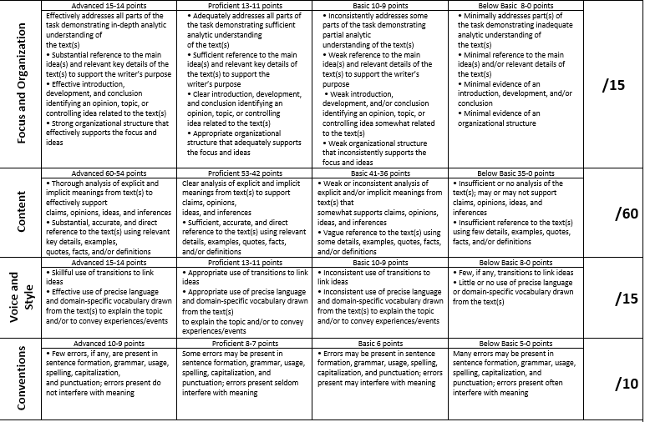
This is the rubric we’ll be using

Slide 18
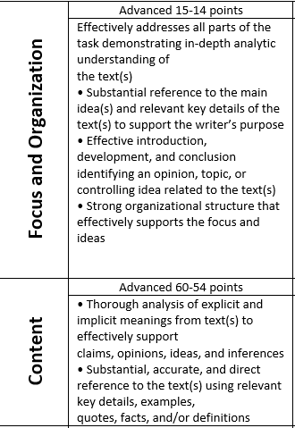
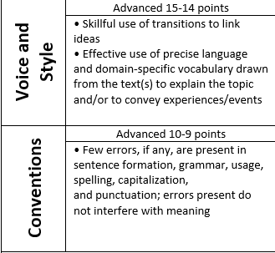
This is what you’re aiming for

Slide 19
Building our Skills
I am going to show you all of the tricks I use when writing essays, and a few things you can do to avoid some of our most common mistakes.
Make note of skills you would like to use later (ensure that by the end of this, you have down at least three).

Slide 20
Read your work aloud before you turn it in

Slide 21
Clearly state your thesis in your introduction and come back to it

Slide 22
Steal words from the prompt

Slide 23
Always use specific words
Words to avoid: many, most, every, very, all
Ask yourself: can I support this claim, or is it too big?

Slide 24
Trouble finding quotes? Amazon prime is your friend.
Go to amazon.com
Find your book, click.
Click on the cover to look inside
There is a search bar that says “search inside this book”
Type in the key word you’re looking for
Sort through the results.

Slide 25
Stating opinions without using “I”: “one could argue”, “evidence suggests”, or just state it as fact.

Slide 26
Quotations:
This is a big one. We’re going to have a PowerPoint within a PowerPoint for this one.

Slide 27
Hey In-Text Citations! Let’s Gooooooooooo!!!
It’s pretty simple. You are writing your paper. Having a great time (obvi), and then, when you make a really direct claim, you need to back it up by using a quote.
You will (in all likelihood) write a 5 paragraph essay
It’s not a rule, it’s just a simple go-to
Each paragraph should present a different reason why your claim is right

Slide 28
Easy ways to cite:
Want to make a direct claim? Use a colon:
Lily was shocked to find that her skin color made her an outsider: “This was a great revelation—not that I was white but that it seemed like June might not want me here because of my skin color” (Kidd 87).
Want to make the author’s words blend into yours?
Use a comma:
It is clear that Lily is learning to take care of others when June rejects Neil, and May “sank down onto the floor, crying.” Lily and August stepped in and “walked her out to her wall…she wrote June and Neil on a scrap of paper and wedged it between the rocks” (Kidd 132).

Slide 29
Always be clear about who is speaking

Slide 30
Provide context and explanation

Slide 31
Chose quotes to analyze events, characters, or theme, not quotes that relay summary

Slide 32
Want to quote something in quotation marks?
Lily was able to bond with August because August always asked the kind of questions that showed true investment in Lily, “‘What else do you love, Lily?’ No one had ever asked me this before” (Kidd, 139).

Slide 33
Or a conversation?
When Lily is angry about her deceased mother’s past, she acts out, making rash comments about August’s decision to keep her out of a mental institution, and hurting August in the process:
You should have let him put her in there. I wish she’d rotted in there.
Lily! (Kidd 252).
It is clear that Lily is acting out in a hurtful way, but regardless of the hurt, August stays by her side as a true mother would.

Slide 34
A quote that goes on for four lines or more?
When Lily first sees the statue of Mary, she feels an immediate connection:
Even though she wasn’t dressed up like Mary, and didn’t resemble the picture on the honey jar, I knew that’s who she was. She had a faded red heart painted on her breast and a yellow crescent moon, worn down and crooked, pained where her body would have blended into the ship’s wood. A candle inside a tall red glass threw glints and glimmers across her body. She was a mix of mighty and humble all in one. I didn't know what to think, but what I felt was magnetic and so big it ached like the moon had entered my chest and filled up (Kidd, 70).
From this moment on, Lily associates Mary with this feeling of fullness.

Slide 35
Always begin and end with your own words

Slide 36
Our biggest area of struggle?
Focus.

Slide 37
How to keep focused?
Keep a copy of your theme statement always visible while writing
If you notice you’re: not talking about the theme statement
OR
Writing summary (this is what happened) instead of analysis (this is how what happened in the book is related to my theme statement), check yourself before you wreck yourself.

