Slide 1
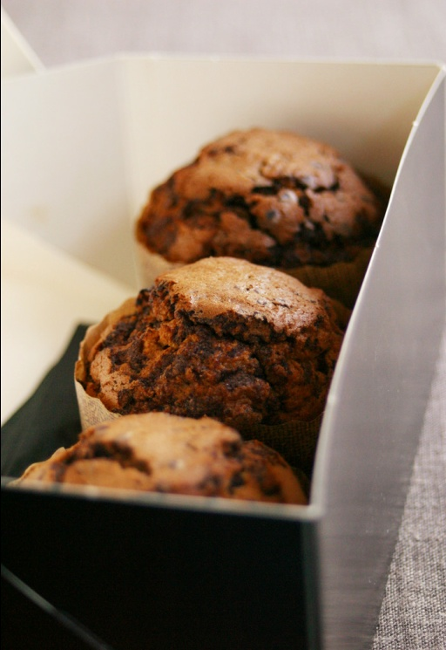
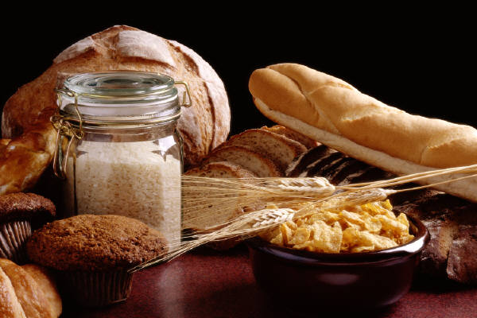
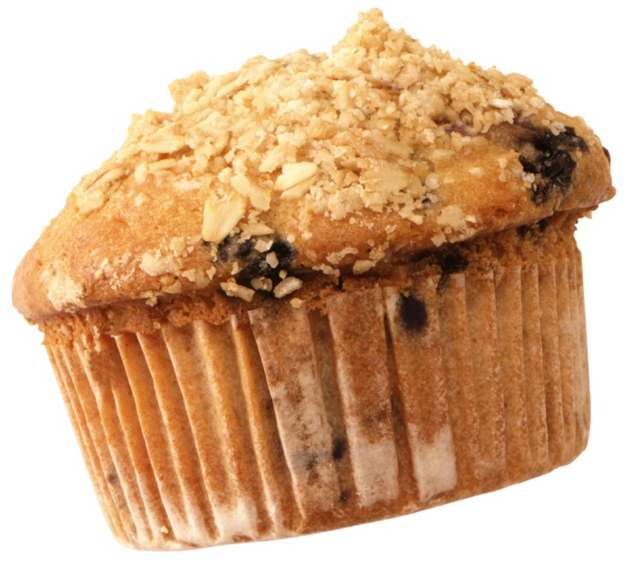

Baking Basics and Lab Procedures:

Slide 2
First things first…
BEFORE you being any recipe or any cooking:
Put your hair back
Read the recipe
Preheat the oven
WASH YOUR HANDS
  Before you get any ingredients or cook
  After you handle raw ingredients
  After you cough, sneeze or blow your nose
  After a trip to the bathroom
Getting the ingredients is ONLY done after you have done these steps, so it is NOT one of the 4 steps

Slide 3
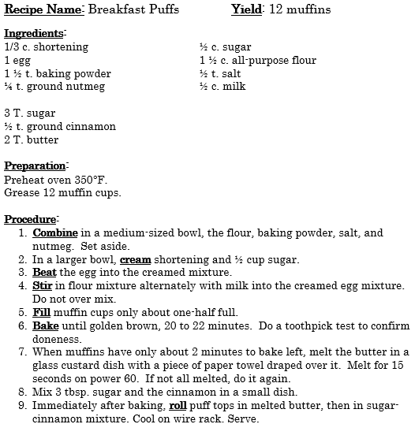
Here is one of our recipes from past classes.
What do you notice?

Slide 4
All Recipes should have…
Ingredients: exact measurements
Temperature/Time/Equipment:
  Temperature to heat oven, pan on stove, or electric skillet
  Time to bake or heat/cook
  Equipment needed to create food
  Directions: exact steps necessary to prepare food
  Yield: how much the recipe makes, if done correctly

Slide 5
Now to get started…
BEFORE you go to the ingredient table:
Everyone reads the recipe, AGAIN
WASH YOUR HANDS (if you didn’t already)
  Before you get any ingredients or cook
  After you handle raw ingredients
Get all your tools/equipment needed to do all the measuring in ONE trip
  Only ONE person gets ingredients during a lab
  Don’t make multiple trips, you WILL make mistakes
Make sure the WHOLE group checks EVERYTHING before you use ANYTHING

Slide 6
Now to get started…
Having everything set up, measured, and ready to go BEFORE completing any directions is:
Mise en place = French term for things in place

Slide 7

Now to get started…
Now to measuring skills. Hover over the video box, click the PLAY arrow to watch and complete the pkt. pg. This info is on the tests.

Slide 8
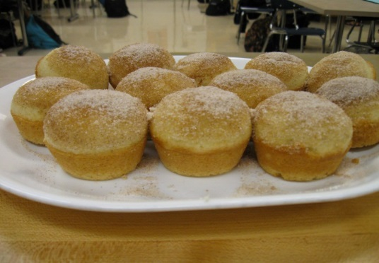
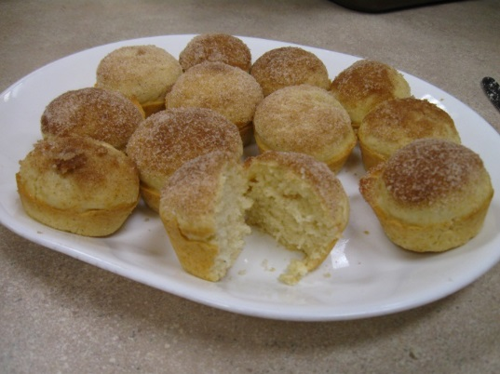
Intro Baking Terms
Keep all ingredients separate until ready to be used. Two measures of the same ingredient are used for two different parts of the recipe. Read to see what goes where.
Mise en place
  Have everything in place/ready BEFORE starting to mix/cook/bake
Cream
  Beat SOLID fat and sugar together until light and fluffy
Alternate
  Add ½ of the dry and then ½ of the wet and mix, repeat
Combine
  Mix ingredients together
Bake
  Cook by heating in oven, dry heat
Notes:
It’s believed that whoopie pies were first made from leftover cake batter, and Amish legend has it that, when children and even farmers would find the delicious treat in their lunch pail, they’d yell out “Whoopie!,” hence the name.

Slide 9
Methods:
ALWAYS bake in the MIDDLE of the oven
Muffins:
  Use the muffin method
    Sift or mix together all dry ingredients
    Make a well/hole in the center
    Beat all liquid ingredients separately until blended.
    Pour the liquid mixture into the dry ingredients
    Stir until just mixed, DO NOT OVERMIX
    Fold in any nuts or fruits gently.
    USE ALL BATTER, NO WASTE!!

Slide 10
Multiple Muffins Lab
TIPS:
Grease muffin tins over trash or sink, not floor
Use hand mixer, do NOT use the whisk to combine the liquid and dry ingredients – too thick = wasted batter
Fill muffin cups only ½ full to prevent overflow, be sure they are the same size so they cook evenly
Bake in the middle of the oven, too high = burned sides, if the racks aren’t in the correct place, move them before you turn on the oven
DO NOT over mix the batter
Bake at lowest time, you can add more if toothpick test shows they are underdone
Melt butter in custard dish with paper towel over it on power 6 so that it doesn’t spatter all over
Run a knife around the muffins to release them
Your muffin picture here:
I’m taking pictures of really good foods, so maybe yours will make it. ☺
Notes:
It’s believed that whoopie pies were first made from leftover cake batter, and Amish legend has it that, when children and even farmers would find the delicious treat in their lunch pail, they’d yell out “Whoopie!,” hence the name.

Slide 11
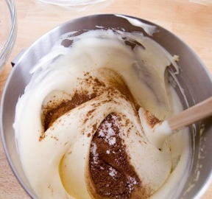
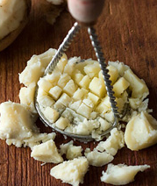
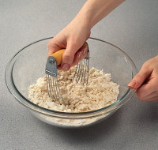
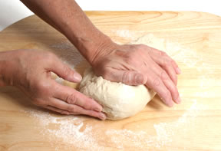
OTHER BASIC TERMS
Fold
  Gently stir from bottom to top to incorporate ingredients like fruit or nuts
  Mash
  Squish into small pieces or a paste
Cut-in
  Using a pastry blender, cut fat into flour/dry ingredients until the size of coarse crumbs
Knead
  Mix dough together using heels of hands to combine ingredients and develop gluten

Slide 12
Multiple Cookies Lab
TIPS:
Use hand mixer first, do NOT use the whisk to combine the liquid and dry ingredients – too thick = wasted batter
Be sure cookies are the same size so they cook evenly
Bake in the middle of the oven, too high = burned sides, if the racks aren’t in the correct place, move them before you turn on the oven
If you have two baking sheets, switch places in the oven half way through the cooking time
Bake at lowest time, you can add more if they are underdone – the tops of the cookies should be firm to the touch
Present on front table for grading – do NOT eat before graded – EARN ZERO
Clean as you go, NEVER WASH THE SIFTER – only wipe out with damp cloth or you will rust it. Wash the shortening tools LAST and make sure they are NOT greasy.
Your cookie picture here:
I’m taking pictures of really good foods, so maybe yours will make it. ☺
Use 2 baking sheets and switch halfway through baking.
USE ALL THE dough– NO WASTE!
Make all cookies the same size.
Notes:
It’s believed that whoopie pies were first made from leftover cake batter, and Amish legend has it that, when children and even farmers would find the delicious treat in their lunch pail, they’d yell out “Whoopie!,” hence the name.

Slide 13
ALL Labs
All students will read all of the directions before starting
One person (different from last time) comes to table to get ingredients
Everyone helps out and cleans as you go so you aren’t late
Time management is very important. Follow the times given for oven use
You will create a presentation on the platter BEFORE you eat anything – if it isn’t graded and you eat it, it earns a zero
Turn in all hardware (muffin tins, baking sheets, cooling racks)
Table clean up group cleans front table
Clean your entire kitchen – dishes, tools, counters, oven, floor…
All extra food gets donated to the local food pantry – if you are not going to eat it, do not leave with it. ☺

Slide 14
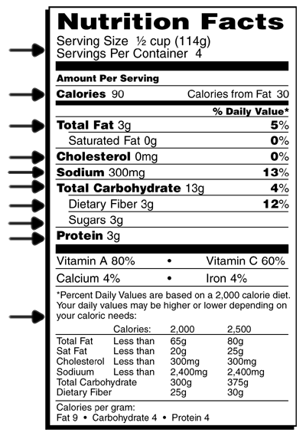
Nice to know…
Nutritional information: per serving
  Calories
  Fat, total and specific kinds
    Saturated
    Unsaturated
    Trans
  Cholesterol
  Sodium
  Carbohydrates
  Protein

Slide 15
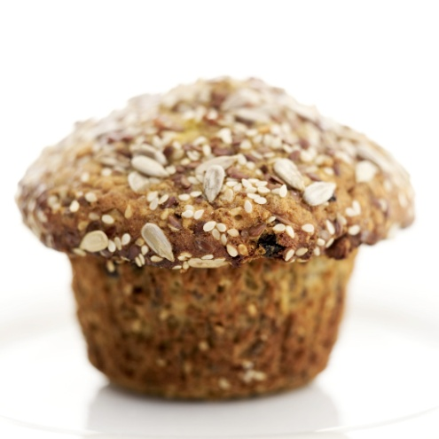
Ingredients:
Nutritious items include:
  Carbs
  Protein
  B-vitamins
  Iron
  Using whole grains, fruits, & nuts adds fiber, vitamins & minerals
  Quick breads provide variety to your diet.

Slide 16
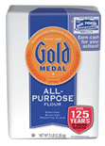
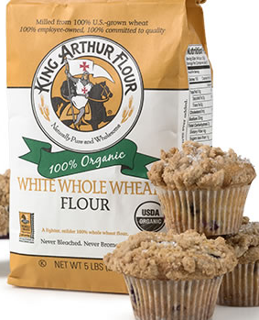
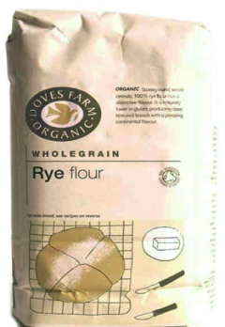
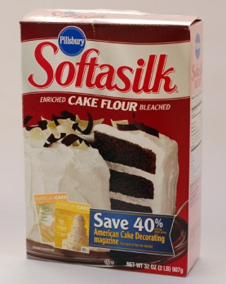
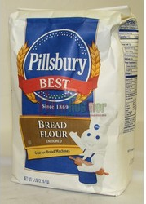
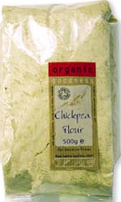
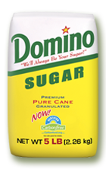
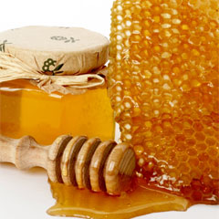

Ingredients:
Flours:
  White
  Wheat
  Rye
  Cake – which is lighter, less gluten
  Bread – which has highest gluten, for strong structure
  Other gluten free choices include:
    Bean
    Tapioca
    Rice
  Sweeteners:
    Sugar
    Honey
    Juices

Slide 17
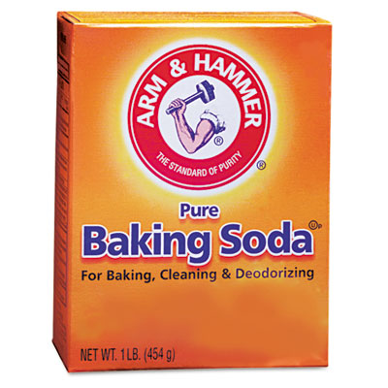
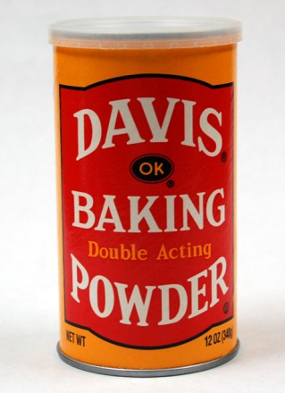
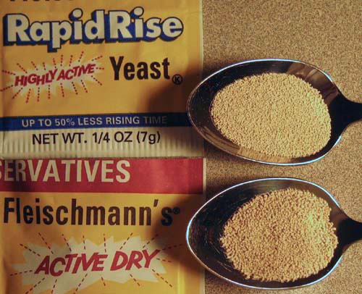
Ingredients:
Leavening agents:
  Baking Soda – used when you need an acid to activate, such as buttermilk, yogurt, or sour cream, it also releases CO₂ when it is mixed with liquid
  Baking Powder – made from baking soda and cream of tartar (or other acid base), releases CO₂ when it is mixed with liquid, so it’s quick and lasts throughout the baking process
  Yeast – a micro-organism that gives off CO₂ when it grows
  Air – when air that is trapped in a batter heats, it expands, making the product rise
    Trap air by:
      Whipping egg whites
      Creaming fat and sugar
      Sifting flour
  Steam– when water that is trapped in a batter heats, it expands, making the product rise

Slide 18
Ingredients:
Fats (provide richness, flavor and tenderness):
  Solid – butter and shortening
  Liquid – oils
  Eggs (add flavor, nutrients, richness and color):
    Eggs
    Egg substitutes

Slide 19
Methods:
Biscuits:
  Use the biscuit/pastry mixing method
    Sift or mix together all dry ingredients
    Cut in the shortening/fat until the size of coarse crumbs
    Beat all liquid ingredients separately until blended.
    Pour the liquid mixture into the dry ingredients
    Fold in any nuts or fruits gently.
    Knead gently until just mixed, DO NOT OVER KNEAD

Slide 20
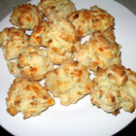
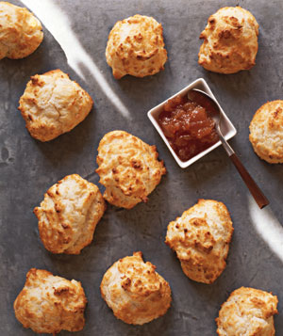
Methods:
Drop Biscuits:
  Use the drop biscuit method
    After mixing biscuit dough together, use a spoon to drop uniformly sized globs of dough onto usually greased baking sheets
    Best for shortcakes or biscuits
    with gravy
    USE ALL DOUGH, NO WASTE!!
http://www.google.com/imgres?imgurl=http://img4.realsimple.com/images/food-recipes/recipe-collections/0511/drop-biscuits_300.jpg&imgrefurl=http://www.realsimple.com/food-recipes/browse-all-recipes/drop-biscuits-10000001118652/index.html&h=357&w=300&sz=38&tbnid=imFU0Epd-O5tAM:&tbnh=245&tbnw=206&prev=/images%3Fq%3Ddrop%2Bbiscuits%2Bpicture&zoom=1&q=drop+biscuits+picture&hl=en&usg=__5AiiLc2Amv_j9Ti-v62v1QWYpBo=&sa=X&ei=2JjaTJChOISs8Abmia2jCA&sqi=2&ved=0CBwQ9QEwAQ

Slide 21
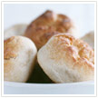
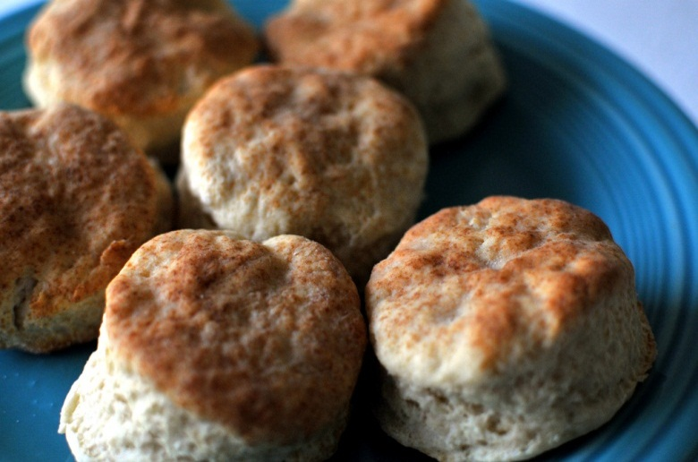
Methods:
Rolled Biscuits:
  Use the rolled biscuit method
    After mixing biscuit dough together, lightly knead the dough, roll out and cut into shapes such as circles or use cookie cutters
    Bake on greased baking sheets
USE ALL DOUGH, NO WASTE!!

Slide 22

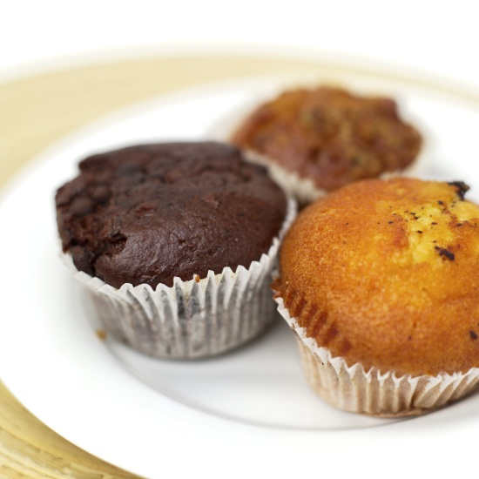

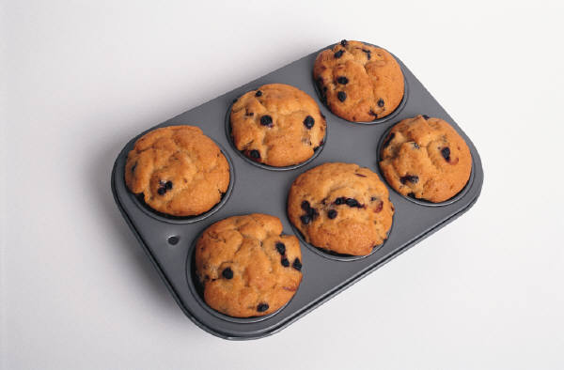
Types:
Quick breads:
  Sweet – usually have fruit or nuts, and sugar for flavor
  Savory – usually have spices, even vegetables, cheeses or meats
  Filled – fillings can include cream,
  jelly, chocolate, and so on

Slide 23
Baking Temps and Times:
Common baking temperatures are between 350º and 425º F
Times range according to the size of the baked good. The smaller the item, the less time is needed.
  8-10 minutes for some cookies
  18-25 minutes for most muffins
  30-40 minutes for most cakes
  45- 60 minutes for some yeast breads

Slide 24
Characteristics of a great baked good:
Nicely browned – affected by sugar content
Rounded top – if peaked, it was over mixed which will leave a tough inside
Tender interior – bread should be somewhat moist, add-ins should be evenly distributed, not all on the bottom

