Slide 1
Understanding Economic Systems
Communism, Socialism, Capitalism
Adapted from a presentation created by Mr. Blair

Slide 2
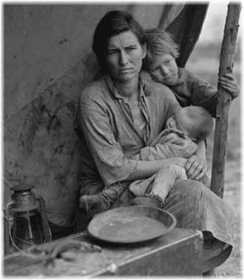
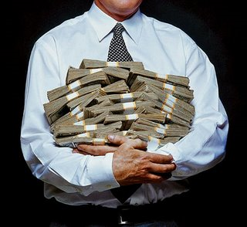
Warm Up Question #1
What standard of living do you hope to attain in life? How do you plan to accomplish this goal?

Slide 3
Main Idea
Economies vary when it comes to government involvement. The relationship between government and the economy has been debated since America’s historical beginnings.

Slide 4
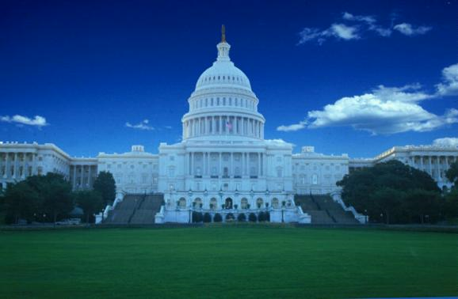
Essential Question
What role should a government play in an economy?

Slide 5
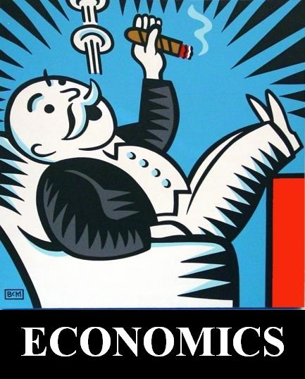
I. Understanding Economic Systems
A. Economics – the social science that analyzes the production, distribution, and consumption of goods and services.
B. Many different economic systems in the world
C. Helps formulate our understanding of Modern American History

Slide 6
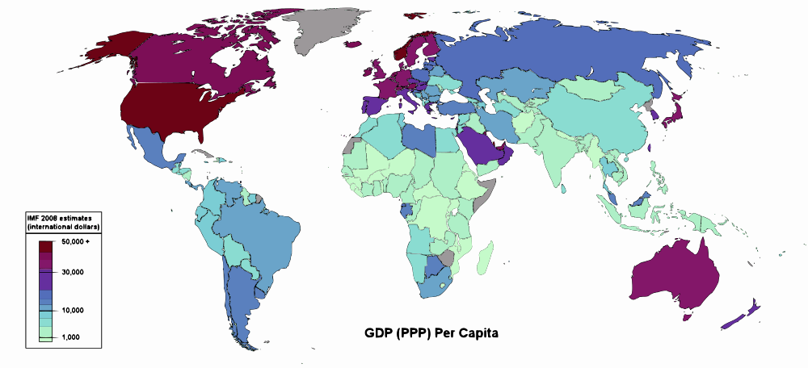
Economies of the World - 2008
According to this map, which are amongst the world’s wealthiest nations?

Slide 7
II. Economic Systems
Capitalism
An economic system in which factories, equipment, or other means of production are privately owned rather than controlled by the government.
Example – United State of America

Slide 8
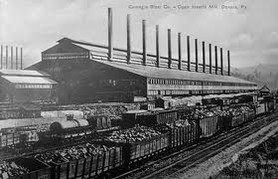
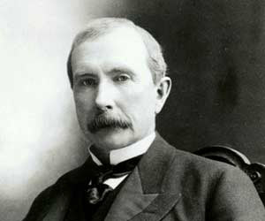
Laissez-Faire
Capitalism (continued)
A. The idea that the free market, through supply and demand, will regulate itself if government does not interfere
B. Government should be “hands off” with big business
C. Highest form of capitalism
D. Ex. Rise of Industry in America in 19th Century
John D. Rockefeller founder of Standard Oil had a net worth of $668 Billion

Slide 9
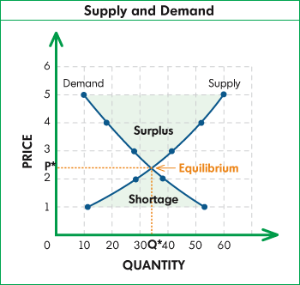
Supply & Demand
Capitalism (continued)
The way a market regulates itself in a capitalist society
In your Social Studies Journal add the following visualization.
So how does this work?

Slide 10
Socialism
A political and economic theory that advocates ownership of the means of production, such as factories and farms, by the people rather than by capitalists and land owners.
Power belongs to the working class
Ex – China, Yugoslavia (parts of U.S.S.R.)
The symbol of the Soviet Union featured the hammer and sickle symbols of laborers for centuries

Slide 11
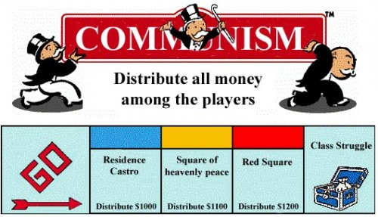
Communism
An economic or political system in which the state or the community owns all property and the means of production, and all citizens share the wealth.
Creates a classless society (theoretically
Ex – Vietnam, Cuba, U.S.S.R.

Slide 12
 | Capitalism (Market economy) | Socialism (mixed economy) | Communism (Command economy)
Ownership and control
Competition
Standard of Living
Basic means of production owned and managed by government
Private ownership, with regulation, of businesses
Individuals control means of production
Market determines what goods will be sold at what price
Government owns means of production
Government determines what goods will be sold at what price
Competition keeps prices low and quality high
No competition, lower quality goods
Cooperation stressed over competition
high standard of living and economic security
Individuals free to earn profits, but may risk losses
high standard of living and economic security
High taxes provide free health care and education
Goal is equality for everybody, enforced by the government

Slide 13
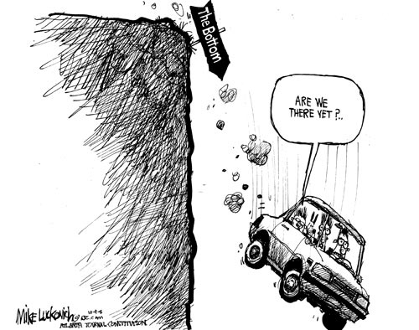
Economic Scenarios
Work with your table groups to demonstrate your understanding of economies.
Analyze the following scenarios and then identify the type of economy that is being described in the statement.

Slide 14
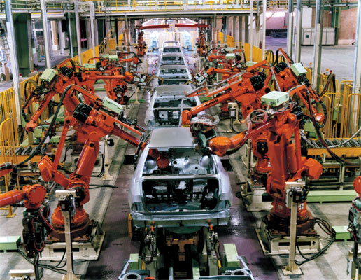
Scenario #1
In this economy manufactures of automobiles control the number of vehicles produced each month in a effort to avoid surpluses that would minimize their profits.

Slide 15
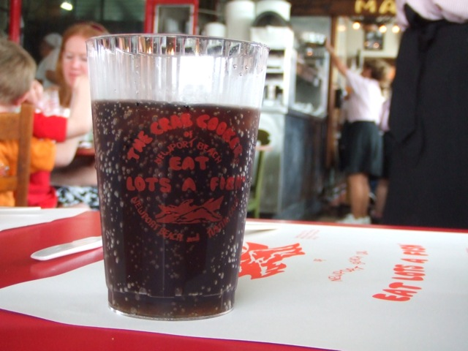
Scenario #2
In this economy, the government produces it’s signature crab flavored soft drink and determines that it will be sold for $1.25 in all stores.

Slide 16
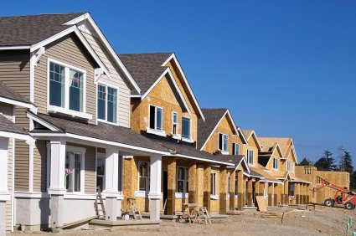
Scenario #3
In this economy, investors can make millions investing in the construction of new homes, but it is just as likely that the value of these properties could decrease by 40% and they will lose millions of dollars.

Slide 17
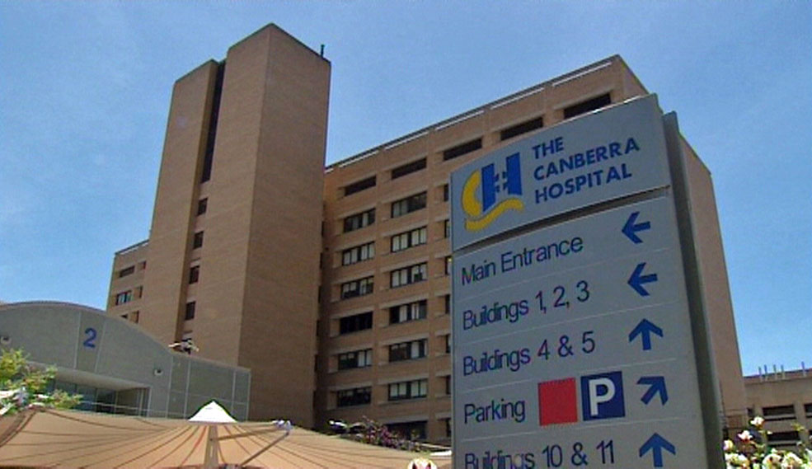
Scenario #4
In this economy, unemployment is around 3% and although taxes are high, all members of the society have access to good schools and hospitals.

Slide 18
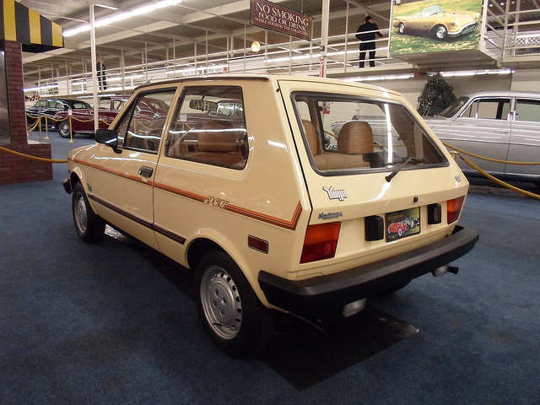
Scenario #5
In this economy, there are only 3 types of automobiles to choose from. They often break down and they are all painted a light brown color.

Slide 19
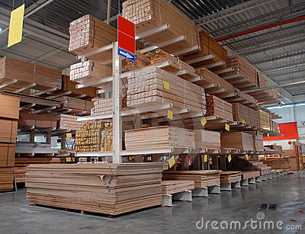
Scenario #6
In this economy, you are the owner of construction company, but all your materials to build houses is regulated by the government to ensure safe housing for all.

Slide 20
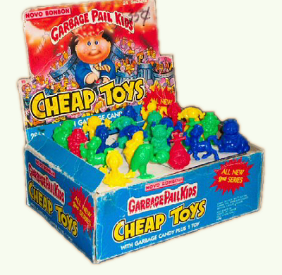
Scenario #7
In this economy, the value of goods fluctuates greatly and as a company you must continue to produce quality goods, or risk being out of business.

Slide 21
Creating a Visual Reminder – Supply & Demand
These concepts are complex, yet understanding them is essential to our discourse this year.
With the time remaining in class, I am asking you to create a visual reminder, with your table group for supply & demand.
Supply
$ Price $
Supply
$ Price $
Demand
$ Price $
Demand
$ Price $

Slide 22
America’s Mixed Economy
Work with your table group to read the article about America’s current mixed economy.
Respond to the essential questions after reading
Class discussion to follow

