Slide 1
Week 36: May 9-13, 2016
Decades of Change
(Ch. 23-24)

Slide 2
Why are we here this week?
Students will examine two chapter topics as part of Unit IV: Ch. 23: Era of Social Change and Ch. 24: Age of Limits. Ch. 23 study ends Tuesday with a game & QUIZ, then students will explore Ch 24.
COMPUTER LAB 341 on Friday for Unit IV and/or Ch. 24 study session!

Slide 3
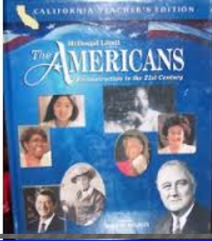
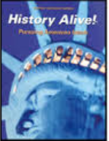
Unit IV: Decades of Change Be ready to listen to peers, read along in textbooks, ASK questions, complete an collaborative, open-book assessment, & then participate in a learning activity. There will be an individual objective QUIZ for each chapter.
Day 1: Teach “ttt” via PowerPoint
Day 2: Socratic Symposium, followed by “textbook test”
Day 3: Game, then QUIZ
The Americans
Visit Robinson SHARES folder for Ch. 20-24 “tttSociety: ” answers. SKIM textbook(s).
20…New Frontier & Great Society
Monday, 4/25→Wed. 4/27
21…Civil Rights: Thursday, 4/28→M/5/2
22…Vietnam Years: Tuesday, 5/3→TH/5/5
23…Era of Social Change: Friday, 5/6→T/5/10
24…Age of Limits: Wednesday, 5/11→M/5/16
Collaborative “chapter tests” will be worth 20 minor points.
Chapter quizzes (5) will be worth roughly 20-25 major points.
Be sure to READ & complete “ttt” questions and Alive! fill-in notes & exercises BEFORE peers teach!
History Alive!
Summaries (in Shares) contain fill-in NOTES.
43, 48, 49
44, 45, 46 (47)
51, 52, 53
47, 50, 55
53, 54, 55
4th district exam will be on or soon after Monday, May 23rd

Slide 4
http://www.amazon.com/White-Mountain-Puzzles-The-Sixties/dp/B000H0S1TU

Slide 5
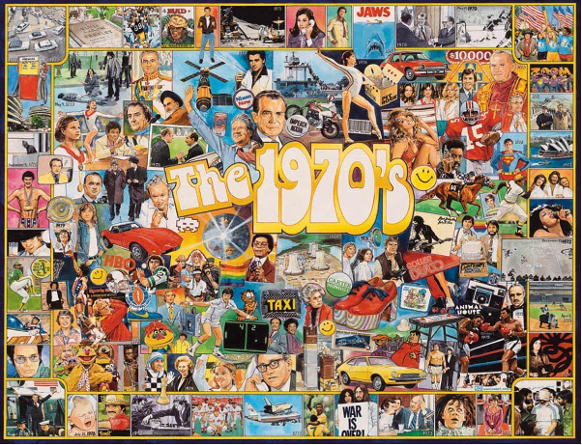
http://www.amazon.com/White-Mountain-Puzzles-The-Seventies/dp/B001BSH4VI

Slide 6
Homework: Ch. 23: Era of Social Change “ttt” & Alive! Ch. 47, 50, 55
work due Monday
*Ch. 22 self & peer evaluation due Monday
Friday→Tuesday, May 6-10 2016
Decades of Change PROJECT
Ch. 23: Era of Social Change
The Americans, Ch. 23
History Alive! Ch. 47, 50, 55

Slide 7
Homework: Ch. 23: Era of Social Change “ttt” & Alive! Ch. 47, 50, 55
work due Monday
*Ch. 22 self & peer evaluation due Monday
Friday, May 6, 2016
Decades of Change PROJECT Day #1
Ch. 23: Era of Social Change
The Americans, Ch. 23
History Alive! Ch. 47, 50, 55

Slide 8
Homework: STUDY for individual QUIZ: Ch. 23: Era of Social Change
& Alive! Ch. 47, 50, 55
*Ch. 22 self & peer evaluation due today!
Monday, May 9, 2016
Decades of Change PROJECT Day #2
Ch. 23: Era of Social Change
Collaborative assessment…20 pts
Ch. 23 “ttt” & HA Ch. 47, 50, 55 due…30 pts

Slide 9
Homework: Ch. 24 “ttt” & Alive! Ch. 54 due work due Thursday
*Ch. 23 self & peer evaluation due Thursday!
Tuesday, May 10, 2016
Decades of Change PROJECT Day #3
Ch. 23: Era of Social Change
GAME DAY, then individual QUIZ…25 points
The Americans, Ch. 23
History Alive! Ch. 47, 50, 55

Slide 10
Chapter 23, Americans p. 766 -789 An Era of Social Change
Responses will vary but should include points similar to the following:
1. To win higher wages and better benefits, Latinos farm workers organized into a union. Other Latinos formed political groups to field candidates.
2. Many Native Americans, unhappy with past government policies, came together to issue the Declaration of Indian Purpose, which called for freedom to choose their own way of life. Some Native Americans formed the American Indian Movement to push for faster results. Others used lawsuits to win education and land rights.
3. The women’s movement succeeded in winning better treatment on the job and better access to education. But it failed to win approval of the Equal Rights Amendment.
4. The counterculture faded because hippies found they could not survive without mainstream society and because of problems caused by drugs. It changed art and fashion and helped increase the influence of rock ’n’ roll, however.

Slide 11
Chapter 23 Americans, p. 766-789
An Era of Social Change
1. What did Latinos do to fight for equality?
To win higher wages and better benefits, Latino farm workers organized into a union. Other Latinos formed political groups to field candidates.

Slide 12
Chapter 23 Americans, p. 766-789
An Era of Social Change
2. What did Native Americans want?
Many Native Americans, unhappy with past government policies, came together to issue the Declaration of Indian Purpose, which called for freedom to choose their own way of life. Some Native Americans formed the American Indian Movement to push for faster results. Others used lawsuits to win education and land rights.

Slide 13
Chapter 23 Americans, p. 776-779
An Era of Social Change Alive! 716-717
3. Describe the successes and failures of the women’s movement in the 1960s.
The women’s movement succeeded in winning better treatment on the job and better access to education. But it failed to win approval of the Equal Rights Amendment.
-Roe v. Wade; birth control pill; more women attended higher education; Betty Friedan wrote The Feminine Mystique
-ERA is defeated; Bella Abzug & Gloria Steinem (activist & creator of Ms. Magazine) (NWPC); NOW (National Organization for Women); comparable worth ($); “glass ceiling”
Additional details/answers?

Slide 14
Chapter 23 Americans, p. 781-784
An Era of Social Change Alive! Ch. 50, p. 649-653
4. What caused the downfall of the counterculture and what lasting value did it have?
The counterculture faded because hippies found they could not survive without mainstream society and because of problems caused by drugs. It changed art and fashion and helped increase the influence of rock ’n’ roll, however.
--Woodstock (3 days of peace, love, & music); famous rock stars died (Jimi Hendrix & Janis Joplin); Haight-Ashbury-San Francisco, CA “hippie capital”; Beatles arrive 1964;
-The Beat Movement (Beatniks) of the 50s evolved into the “hippies” of the 60s & 70s

Slide 15
History Alive!
Ch. 43: Two Americas
Why did poverty exist in an age of influence?
Michael Harrington’s The Other America revealed that despite the general affluence of the 1950s, millions of “socially visible” Americans lived in poverty. Although people’s views and understanding of poverty have changed over time, the problem persists.
Defining poverty Pauperism was once considered a moral failure. Today, poverty is defined in terms of income. People below the poverty line do not have enough income to live decently.
An invisible class In The Other America, Michael Harrington argued that the poor were “invisible” for many reasons. They lived apart from the middle class but looked much the same. They also played no role in politics.
Urban poverty Impoverished minorities became concentrated in decaying cities when the middle class moved out. The Housing Act of 1949 launched urban renewal programs to clear out slums and build new housing. However, many of these housing projects became slums.
Rural poverty The growth of agribusiness harmed many farmers. Migrant workers on corporate farms were not paid enough to lift them out of poverty. One of the poorest rural regions, Appalachia, suffered from poor farming conditions and a declining coal industry.
American Indian policy Efforts by the federal government to “terminate” its responsibility for Indian tribes led to increased poverty among Native Americans. The Voluntary Relocation Program helped Indians move to cities, but many had trouble adapting to urban life.
The “other America” today Despite government efforts, poverty is still a significant problem in the United States. About 37 million Americans lived in poverty in 2005. Today’s poor are younger and more diverse than those of the past. They are also more visible in society.

Slide 16
Ch. 47: The Widening Struggle
Why and how did the civil rights movement expand?
The civil rights movement inspired many Americans to stand up for their rights. During the 1960s and 1970s, various groups sought equal treatment under the law and in society.
Women The National Organization for Women (NOW) and other feminist groups worked for women’s rights. They wanted reforms to ensure greater equality and opportunity for women.
Latinos Various groups of Latinos struggled for their rights and identity in American society. The United Farm Workers (UFW) organized migrant farmworkers and helped increase their wages and benefits. The 1968 Bilingual Education Act required public schools to provide bilingual instruction.
American Indians The American Indian Movement (AIM) protested unfair treatment of American Indians. By the mid-1970s, some tribes had won payment for lost lands.
Asian Americans Asian American students asked for university programs in ethnic studies. The Japanese Americans Citizens League (JACL) sought compensation for internment during World War II.
Other groups Disabled Americans fought for equal access and won passage of the Americans with Disabilities Act. After the Stonewall riots, gay Americans gained greater visibility in their fight for equal rights. Older Americans countered ageism by working through such groups as the Gray Panthers.

Slide 17
Ch. 50: The Emergence of a Counterculture What was the impact of a counterculture on American society?
Members of the counterculture valued individual freedom and expression over materialism. Their values created a generation gap between themselves and older, mainstream Americans.
The New Left Politically active college students formed a movement known as the New Left. In 1964, the Free Speech Movement challenged the University of California at Berkeley.
Hippies Members of the counterculture, known as hippies, believed in peace, love, and individual freedom. They shunned the Establishment and its materialistic values.
Sexual revolution As living together before marriage and getting divorced became more accepted in the 1960s, the divorce rate went up, as did the number of children living with a single parent.
Drug use Casual attitudes toward the use of illegal drugs shocked mainstream America.
Rock ’n’ roll Psychedelic rock combined musical styles with light shows to create vivid experiences. The music festival Woodstock drew media attention to the counterculture.
Impact of the counterculture The media introduced countercultural values to mainstream America through television and radio, as well as art, music, and theater.

Slide 18
Ch. 55: Politics and Society in the “Me Decade” How should historians characterize the 1970s?
During the 1970s, the U.S. economy suffered from stagflation as the nation faced a number of crises. The decade was also a time of changing views about everything from the environment and ethnicity to retirement and gender equality.
Organization of Petroleum Exporting Countries A major cause of inflation was OPEC’s decision to raise the price of oil. This led to rising prices for many goods.
National Energy Act In 1978, Congress tried to reduce U.S. dependence on imported oil. The National Energy Act offered incentives for conserving energy or using alternative energy sources.
Camp David Accords In 1978, Jimmy Carter brokered a peace agreement between Israel and Egypt. The Camp David Accords ended the long state of war between these two countries.
Earth Day The first Earth Day celebration in 1970 signaled the emergence of a new environmental movement. Followers worked to clean up and protect the environment locally and globally. Congress passed antipollution laws such as the Clean Water Act and the Safe Drinking Water Act.
Three Mile Island accident An accident at the Three Mile Island Nuclear Generating Station in 1978 highlighted the potential dangers of nuclear energy.
Searching for meaning During the 1970s, many Americans turned inward to search for meaning. Some explored self-help movements, others new religions, and others their ethnic identity.
Population changes Fewer births and longer life expectancies led to an aging of the U.S. population. The population also shifted south, as people migrated from the Rustbelt to the Sunbelt.
Gender equality Women worked to gain greater equality in the workplace and politics. In growing numbers, women entered professions that had once been dominated by males.

Slide 19
Homework: Ch. 24 “ttt” & Alive! Ch. 54 due work due Thursday
Collaborative assessment 5/12; QUIZ Monday, 5/16
*Ch. 23 self & peer evaluation due Thursday!
Wednesday, Thursday, May 11-12, & Monday, May 16 2016
Decades of Change PROJECT
Ch. 24: Age of Limits
The Americans, Ch. 24
History Alive! Ch. 53, 54, 55

Slide 20
Homework: Ch. 24 “ttt” & Alive! Ch. 54 due work due tomorrow
Collaborative assessment 5/12; QUIZ Monday, 5/16
*Ch. 23 self & peer evaluation due Thursday!
Wednesday, May 11, 2016
Decades of Change PROJECT Day #1
Ch. 24: Age of Limits
The Americans, Ch. 24
History Alive! Ch. 53, 54, & 55

Slide 21
Homework: STUDY for individual QUIZ: Ch. 24: Age of Limits
& Alive! Ch. 53, 50, 55
*Ch. 23 self & peer evaluation due today!
Thursday, May 12, 2016
Decades of Change PROJECT Day #2
Ch. 24: Age of Limits
Collaborative assessment…20 pts
Ch. 24 “ttt” & HA Ch. 54 due…20 pts

Slide 22
Homework: STUDY for Monday’s QUIZ: Ch. 24 & Alive! Ch. 54 & 55
*Ch. 24 game is Monday!
Thursday, May 12, 2016
Decades of Change PROJECT Day #3
Ch. 24: Age of Limits
GAME DAY, then individual QUIZ…25 points
The Americans, Ch. 24
History Alive! Ch. (53), 50, 55

Slide 23
Chapter 24, Americans p. 792-827 An Age of Limits
Responses will vary but should include points similar to the following:
1. Nixon reversed past U.S. policy by opening relations with Communist China and pursued more friendly relations with the Soviet Union.
2. The cover-up of Watergate represented the president’s effort to block investigations, thus trying to put himself above the law.
3. Ford tried to end inflation with energy conservation and higher interest rates. Carter tried to use voluntary price freezes and spending cuts.
4. The debate over environmental laws focus on the need for economic development and for protection of natural resources.

Slide 24
Chapter 24 Americans, p. 792-827
An Age of Limits Alive! P. 697-707
1. How did Nixon ease Cold War tensions?
Nixon reversed past U.S. policy by opening relations with Communist China and pursued more friendly relations with the Soviet Union.

Slide 25
Chapter 24 Americans, p. 802-807
An Age of Limits Alive! P. 704-707
2. Why was Watergate a constitutional crisis?
The cover-up of Watergate represented the president’s effort to block investigations, thus trying to put himself above the law.
-Nixon resigned instead of facing impeachment (August 8, 1974); burglary & “high crimes & misdemeanors” were committed (1972) while spying on Democratic National Headquarters; failure to disclose activity led to Nixon’s downfall, & tape recorded conversations sealed his fate

Slide 26
Chapter 24 Americans, p. 792-827
An Age of Limits
3. How did Ford and Carter try to fix economic problems, and why didn’t their plans work?
Ford tried to end inflation with energy conservation and higher interest rates. Carter tried to use voluntary price freezes and spending cuts.

Slide 27
Chapter 24 Americans, p. 792-827
An Age of Limits Alive! p. 714-715
4. What differing needs are the focus of the debate over environmental laws?
The debate over environmental laws focus on the need for economic development and for protection of natural resources.
-Earth Day (4/22/1970); Environmental Protection Act (EPA); Clean Water (1972) and Safe Drinking Water Act (1974); Three Mile Island accident (3/28/1979)

Slide 28
Ch. 53: Getting Out of Vietnam What lessons for Americans emerged from the Vietnam War?
In 1969, President Nixon began withdrawing U.S. troops from Vietnam, but the war continued throughout his time in office. He carried on peace talks with the North Vietnamese but also ordered massive bombing of North Vietnam, Cambodia, and Laos. He faced ongoing protests from the antiwar movement and criticism from Congress. In 1973, the last U.S. combat forces came home. North Vietnam swept to victory over the South in 1975.
Vietnamization Nixon’s Vietnamization of the war allowed for the withdrawal of U.S. troops and prepared South Vietnam to take over responsibility for the war.
My Lai massacre In 1968, U.S. soldiers slaughtered hundreds of Vietnamese civilians in the village of My Lai. Reports of the massacre shocked Americans and increased antiwar protests.
Kent State shootings The invasion of Cambodia in April 1970 sparked an increase in antiwar protests. The most violent one occurred the following month at Kent State University in Ohio, where National Guard troops fired into an angry crowd, killing four students.
War Powers Resolution Congress reacted to Nixon’s activities in Cambodia by passing the War Powers Resolution. This resolution limits a president’s ability to send armed forces into combat.
Pentagon Papers In 1971, Daniel Ellsberg leaked to the press a top-secret study of the U.S. role in Indochina. This study, the Pentagon Papers, revealed secrecy and deceit on the part of U.S. presidents.
Boat people The North Vietnamese defeated South Vietnam and took control in 1975. This prompted an exodus of refugees from Indochina, many of whom fled by boat.

Slide 29
Ch. 54: The Rise and Fall of Richard Nixon What events influenced Richard Nixon’s rise to and fall from power?
Richard Nixon won the presidency in 1968. While in office, he made strides toward easing the tensions of the Cold War. He also saw many of his domestic policies enacted. However, scandal forced him to resign in disgrace in 1974.
New Federalism Nixon came into office determined to revive federalism. He hoped to reduce the power of the federal government and return power to the states. Revenue sharing, central to his plan, allowed state and local governments to spend tax revenues as they saw fit.
Occupational Safety and Health Administration Despite his promise to shrink the federal government, Nixon created OSHA, which works to improve health and safety in the workplace.
Environmental Protection Agency Another new agency, the EPA, was created to protect Americans’ health and the natural environment.
Energy crisis Nixon tried to revive a stagnant economy with increased spending while fighting inflation with wage and price controls. However, an energy crisis made a bad situation worse.
Détente Nixon tried to encourage détente, or a relaxation of Cold War tensions. In 1972, he visited both communist China and the Soviet Union.
Strategic Arms Limitation Treaty In 1972, Nixon and Soviet leader Leonid Brezhnev signed SALT I, the first superpower treaty to place limits on the arms race.
Watergate scandal In 1972, burglars broke into Democratic headquarters in the Watergate building. The scandal over the cover-up that followed the break-in led to Richard Nixon’s resignation in 1974.

Slide 30
Ch. 55: Politics and Society in the “Me Decade” How should historians characterize the 1970s?
During the 1970s, the U.S. economy suffered from stagflation as the nation faced a number of crises. The decade was also a time of changing views about everything from the environment and ethnicity to retirement and gender equality.
Organization of Petroleum Exporting Countries A major cause of inflation was OPEC’s decision to raise the price of oil. This led to rising prices for many goods.
National Energy Act In 1978, Congress tried to reduce U.S. dependence on imported oil. The National Energy Act offered incentives for conserving energy or using alternative energy sources.
Camp David Accords In 1978, Jimmy Carter brokered a peace agreement between Israel and Egypt. The Camp David Accords ended the long state of war between these two countries.
Earth Day The first Earth Day celebration in 1970 signaled the emergence of a new environmental movement. Followers worked to clean up and protect the environment locally and globally. Congress passed antipollution laws such as the Clean Water Act and the Safe Drinking Water Act.
Three Mile Island accident An accident at the Three Mile Island Nuclear Generating Station in 1978 highlighted the potential dangers of nuclear energy.
Searching for meaning During the 1970s, many Americans turned inward to search for meaning. Some explored self-help movements, others new religions, and others their ethnic identity.
Population changes Fewer births and longer life expectancies led to an aging of the U.S. population. The population also shifted south, as people migrated from the Rustbelt to the Sunbelt.
Gender equality Women worked to gain greater equality in the workplace and politics. In growing numbers, women entered professions that had once been dominated by males.

Slide 31
Homework: STUDY for Monday’s QUIZ: Ch. 24 & Alive! Ch. 54 & 55
*Ch. 24 game is Monday!
Friday, May 13, 2016
Computer Lab 341 STUDY DAY!
Ch. 24: Age of Limits
and/or
Unit IV: Decades of Change “study guide in packet"
Americans, Ch. 24 OR Ch. 20-24 Highlights?
Alive! Ch. (53), 50, 55 Safari Montage videos?

Slide 32
Socratic Symposium
Essential Questions?
Enduring Understandings?
“Current” or recent news stories?
Audience questions?
“Resident expert” group questions?
Teacher questions?
OTHER?
All chapter-group students are REQUIRED to make a “meaningful contribution”
ALL students are invited to participate in the “Socratic symposium:” dictionary.com
“A meeting or conference for the discussion of some subject, especially a meeting at which several speakers talk on or discuss a topic before an audience.”

Slide 33
Questions?
What is the most important “thing” to remember about your chapter?
What is a lingering question or concern related to your topic?
What are the “good lessons” to learn from your chapter?
What can we learn from the “failures” related to your topic?
OTHER?
WHY?

Slide 34
Unit IV: Decades of Change
Essential Questions
1. How does social and cultural change (suburban life) impact the individual?
2. How can people change society?
3. How far should the government go to promote equality and opportunity?
4. What happens when the government loses the support of the public?
Did America move closer or further away from its founding ideals in the three
decades after World War II?
Enduring Understandings Students will understand that…
1. People’s values and actions are influenced by the culture that surrounds them.
2. Democracy is an ongoing process that involves struggle and requires cooperation.
3. Individuals and groups can participate to influence the government and reform society, but are often met with opposition.
4. Breaches of trust by leaders damage the public’s confidence in government.

Slide 35
EQ 1. How does suburban life shape the individual?
Effects of the GI Bill and the expansion of suburbanization, including Levittowns.
Influence of popular culture, the role of the mass media, and consumerism.
Criticisms of conformity and the role of women in American society in the 1950s.

Slide 36
EQ 2. How can people change society?
The economic, political and social status of African-Americans living in the North and South after WWII.
Leadership and ideology of Martin Luther King, Jr. and Malcolm X in the civil rights movement and their legacies.
Use of organizations, marches and civil disobedience to change public opinion and pressure government action.
Resistance to civil rights in the South between 1954 and 1965.
Causes and effects of the modern feminism movement.

Slide 37
EQ 3. How far should the government go to promote equality and opportunity?
Role of the legislative, executive and judicial branches in advancing the civil rights movement.
Goals and effectiveness of “Great Society” programs.
A new wave of immigrants from Asia and Latin America after 1965.
Effectiveness of government in addressing social and environmental issues.

Slide 38
EQ 4. What happens when the government loses the support of the public?
The Vietnam policy of the United States Government, including the draft, and the shifts in public opinion about the war.
Nixon administration’s involvement in Watergate and the effects of Watergate on public opinion

Slide 39
EQ 5. Did America move closer or further away from its founding ideals in the three decades after World War II?
How the ideals of liberty, equality, opportunity, rights and democracy were exemplified or contradicted during this time period.

Slide 40
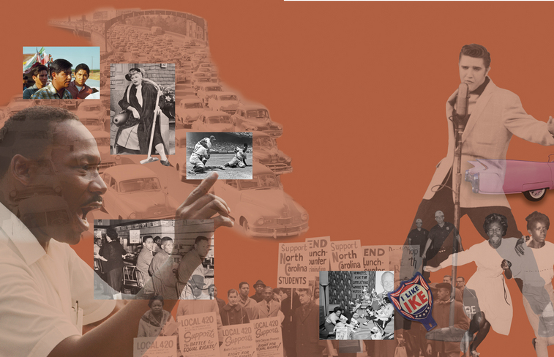
Identify & LABEL as many people & historic events as possible! Then, fill notes below collage
During this era, the United States experienced extraordinary economic growth and broad social changes. Americans got married and had babies in record numbers. Suburbs sprouted like weeds around cities. While most people saw their standard of living rise, hidden pockets of poverty remained. Beneath the calm surface of these years, rebellions were brewing. African Americans’ long battle for equality matured into a civil rights movement that would not be ignored. Once again Americans faced an old question: "When would the nation finally make the ideal that ‘all men are created equal’ a reality?"

Slide 41
Identify & LABEL as many people & historic developments as possible! Fill notes below collage
During this era, the United States experienced extraordinary economic growth and broad social changes. Americans got married and had babies in record numbers. Suburbs sprouted like weeds around cities. While most people saw their standard of living rise, hidden pockets of poverty remained. Beneath the calm surface of these years, rebellions were brewing. African Americans’ long battle for equality matured into a civil rights movement that would not be ignored. Once again Americans faced an old question: "When would the nation finally make the ideal that ‘all men are created equal’ a reality?"

Slide 42
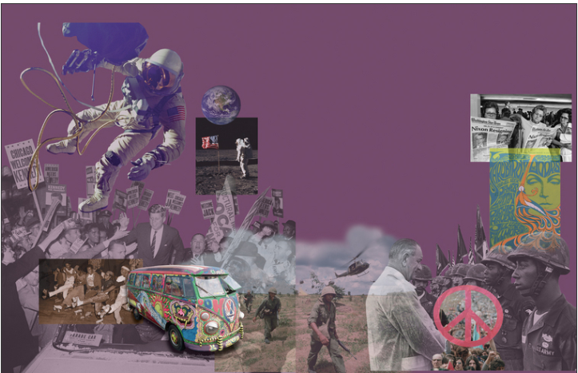
Identify & LABEL as many people & historic developments as possible! Fill notes below collage
This era began with confidence and ended in confusion. It opened with President Kennedy’s inspiring call to service. Over the next two decades, the nation would endure assassinations, an unpopular war, urban riots, political scandals, and an energy shortage. By the end of the era, President Carter would be speaking of a national "crisis in confidence." Carter’s gloom overshadowed many accomplishments. In this time, an American played golf on the moon. War was declared on poverty. Artistic expression flowered. An environmental movement took shape. Still, many Americans were left wondering, "How could the nation’s founding ideals be moved forward in such tumultuous times?"

Slide 43
Identify & LABEL as many people & historic events as possible! Then, fill notes below collage
This era began with confidence and ended in confusion. It opened with President Kennedy’s inspiring call to service. Over the next two decades, the nation would endure assassinations, an unpopular war, urban riots, political scandals, and an energy shortage. By the end of the era, President Carter would be speaking of a national "crisis in confidence." Carter’s gloom overshadowed many accomplishments. In this time, an American played golf on the moon. War was declared on poverty. Artistic expression flowered. An environmental movement took shape. Still, many Americans were left wondering, "How could the nation’s founding ideals be moved forward in such tumultuous times?"

