Slide 1
Unit III District Exam Items The 1920’s, Great Depression, New Deal
Great Depression
Causes
Effects Dust Bowl
Hoover’s response to the Depression
Philosophy
Tariffs
New Deal
Philosophy
Key programs (AAA, FDIC, Social Security)
Legacy
Criticisms of the New Deal
Red Scare
Great Migration
Harlem Renaissance
Scopes Trial
Role of women
Reemergence of the KKK
Mass Media
Superficial wealth
Date: Wed. Jan. 14th
Academic midterm = Friday, January 23rd

Slide 2
Chapter 12, Summary Politics of the Roaring Twenties
Americans’ dislike of foreigners in the 1920s was revealed by the Red Scare, by the rise of the Ku Klux Klan, by a trend towards isolationism and by laws limiting immigration.
2. The labor movement in the 1920s had some successes but mostly went into a period of declining membership, in part because unions were labeled as radicals.
3. Five nations, including the United States, signed an agreement to dismantle parts of their navies. Also, 64 nations signed the Kellogg-Briand Treaty promising to give up war as an instrument of foreign policy.
4. He made poor choices, which brought incidents of bribery and corruption such as the Teapot Dome Scandal and Elk Hills.
5. The business boom was stimulated by a rise in productivity and by the growth of buying on credit.

Slide 3
Chapter 13, Summary The Roaring Life of the 1920s
1. Prohibition—the attempt to make the sale of alcohol illegal—and the conflict between fundamentalism and science symbolized in the Scopes trial
both reveal the clash between new and traditional values in the 1920s.
2. There were more work opportunities for women in the 1920s than in prior years, but they faced discrimination and unequal treatment. Women were becoming more independent and assertive. In their home lives, women more often were free to choose their own husbands, although the divorce
rate increased. They had fewer children. They enjoyed many conveniences that made housework easier.
3. Through national magazines, radio, and movies, the mass media helped create a national culture.
4. Among the personal achievements of the Harlem Renaissance were the writings of Claude McKay, Langston Hughes, and Zora Neale Hurston; the acting of Paul Robeson; and the music of Louis Armstrong, “Duke” Ellington, and Bessie Smith.

Slide 4
Ch. 14: The Great Depression
1. The Great Depression was caused by problems in some major industries such as low demand overseas, weakness of agriculture, the problem of easy credit, and the unequal distribution of income.
2. People in cities suffered greatly as one quarter of the workforce lost their jobs. Farmers suffered as well; low demand kept food prices low, and many farmers lost their farms. African Americans and Hispanic Americans had a higher unemployment rate; those with jobs often had lower-paying jobs.
3. Many men felt devastated by their inability to support their families. Some left home. Many women tried to find work, although they were paid less than men. Many children suffered from lack of food and medical care; many were forced to get jobs.
4. At first Hoover did not believe that the government should play an active role in combating the Depression. While he never had the government give direct aid to people, he did institute projects to create jobs.

Slide 5
Ch. 15: The New Deal
3. Women played a greater role in the government, but still faced discrimination in the workplace. African Americans and Hispanic Americans supported the New Deal but did not receive support for full equality. Native Americans benefited from New Deal policies that recognized their land claims. Unions grew greatly in the New Deal years.
4. Hollywood and the radio offered popular entertainment and escape to millions. Serious artists and writers offered probing critiques of American society or celebrated the virtues of the people. Many writers & artists received funds to work from New Deal programs.
5. The New Deal expanded the power of the federal government. It alleviated the suffering of millions of Americans. It created the social security system and the Tennessee Valley Authority, still around today.
1. In the first New Deal, President Roosevelt tried to reform the banking system, helped farmers by raising food prices, hired jobless workers for building and conservation work, passed the NIRA to promote growth, and created the Tennessee Valley Authority.
2. In the Second New Deal, Roosevelt won passage of new laws conserving soil, providing loans, and offering mortgage relief. The Works Progress Administration gave jobs to millions of workers. Other laws set a national minimum wage, recognized workers’ right to organize, and created the social security system.

Slide 6
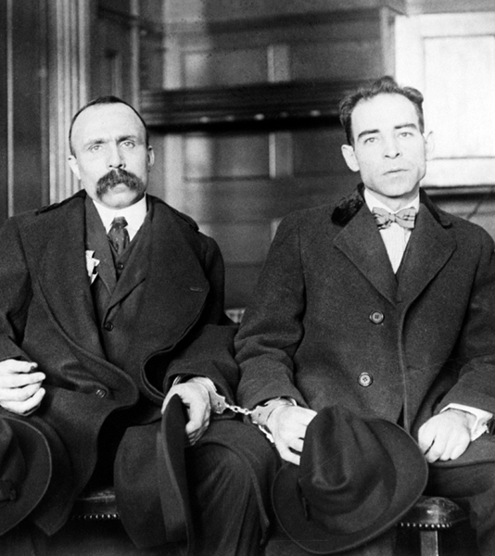
A hotly protested criminal trial, held from 1920 to 1927, in which Italian immigrants Nicola Sacco and Bartolomeo Vanzetti were convicted of robbing and murdering two men and sentenced to death; many people believed that the trial was unfair and that the defendants were prosecuted because they were anarchists, not because they were guilty.
Sacco and Vanzetti

Slide 7
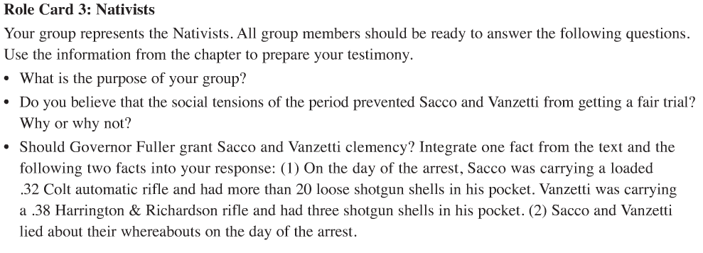
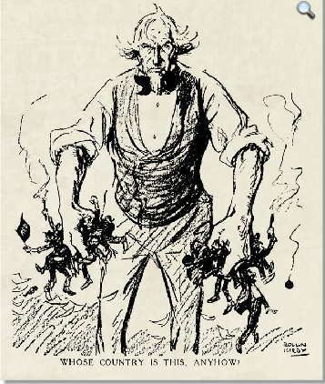
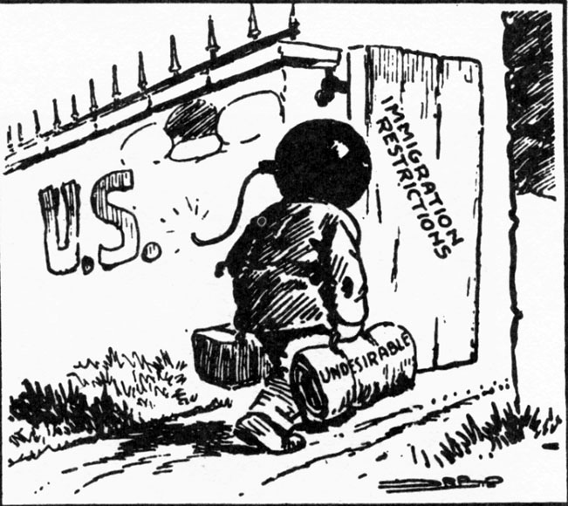
Nativists

Slide 9
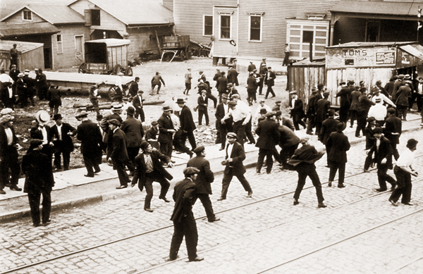
Strike-related violence, such as shown here, fueled some Americans’ fears that radical union activity might lead to revolution. Public fear of radicals contributed to unions’ decline.

Slide 10
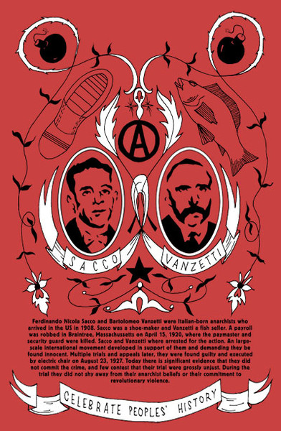
Nicola Sacco became an anarchist while working in a shoe factory. Bartolomeo Vanzetti learned about anarchism while working at a rope factory. The two met in 1917, when they fled to Mexico to escape the military draft. When they returned to Massachusetts, they joined an East Boston anarchists' group.
Vanzetti later boasted, "Both Nick and I are anarchists—the radical of the radical." On the night of their arrest, both were carrying guns. Sacco also had a pamphlet advertising an anarchist rally at which Vanzetti would speak. After their trial, many came to believe that Sacco and Vanzetti had been convicted because of their radical politics.

Slide 11
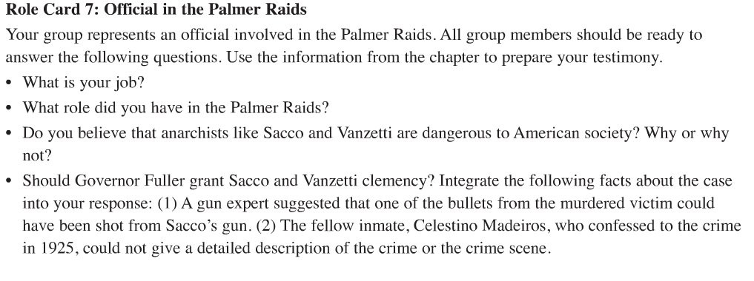
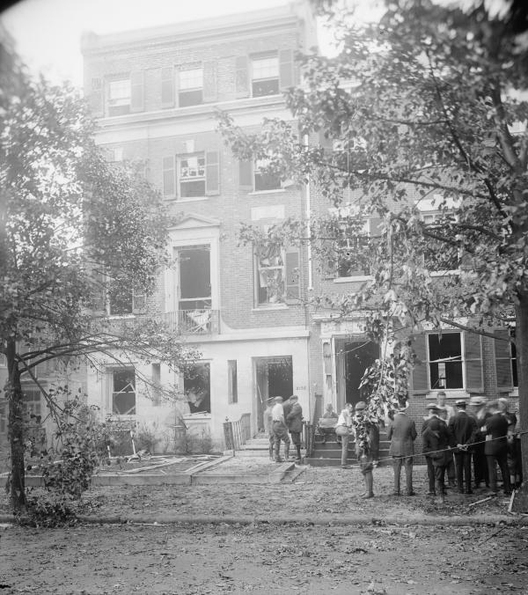
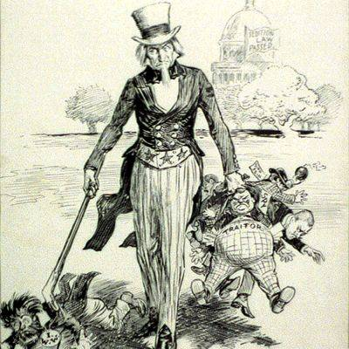
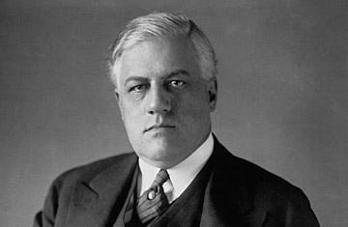
Official in the Palmer Raids

Slide 12
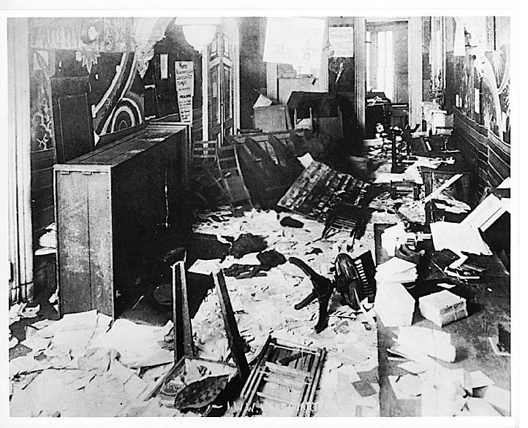
I.W.W. Headquarters After Palmer Raid, 1919
In late 1919, following a period of labor turbulence and several bombing incidents, post-World War I antiradical hysteria reached fever pitch. In November 1919, Attorney General A. Mitchell Palmer launched a series of raids targeting the most vulnerable radical and progressive organizations. By early 1920, more than five thousand people were arrested in what became known as the "Palmer Raids." Goldman's Mother Earth office was among the first to be ransacked in 1917. Rumor has it that J. Edgar Hoover used her confiscated library and manuscripts to educate himself on the radical Left. Apparently, most of the material was later destroyed. (IWW headquarters, New York City, after the raid of November 15, 1919. Special Collections Library, Labadie Collection, University of Michigan)

Slide 13
radicalism: a point of view favoring extreme change, especially in social or economic structure
communism: an economic or political system in which the state or the community owns all property and the means of production, and all citizens share the wealth
Palmer Raids: conducted by Justice Department attorney J. Edgar Hoover at the instruction of U.S. Attorney General Mitchell Palmer, a series of unauthorized raids on homes, businesses, and meeting places of suspected subversives that resulted in the arrest of 6,000 radicals, often without any evidence against them
Notes:
Period 4 ended here Monday, 1/12

Slide 14
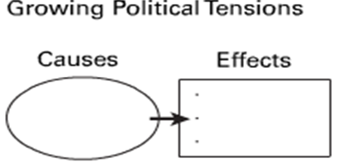
Causes of Political Problems
• In April 1919, authorities discovered 36 bombs and
blamed them on radicalism.
• Americans feared radical groups such as socialists,
communists, and anarchists.
• In June 1919, eight bombs went off simultaneously in
eight cities, one of them targeting Attorney General
Mitchell Palmer.
Effects of Political Problems
• Attorney General Palmer launched the Red Scare, a campaign against subversives.
• During the Palmer Raids, homes and businesses were
raided and thousands of radicals were arrested.
• Some 30 states passed sedition laws.
• Subversive books were removed from libraries.
• Mobs attacked suspected radicals.
• The civil liberties of citizens were violated.

Slide 15
Red Scare
lasting from 1919 to 1920, a campaign launched by U.S. attorney general Mitchell Palmer and implemented by Justice Department attorney J. Edgar Hoover to arrest communists and other radicals who promoted the overthrow of the U.S. government
revived during the Cold War by Senator Joseph McCarthy during a period of anticommunism lasting from 1950 to 1957.

Slide 16
Discrimination
The rising tide of immigrants triggered a resurgence of nativism along with calls for immigration restriction
nativists feared that the latest immigrants would never become "100 percent American.”
Congress responded to anti-immigrant pressure by passing the Emergency Immigration Act of 1921

Slide 17
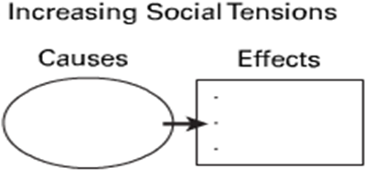
Causes of Social Problems
• Immigration to the United States increased during the early postwar period.
• Many new immigrants were from southern and eastern Europe.
• Nativists called for restrictions in immigration.
• Union members favored tighter immigration laws.
Effects of Social Problems
• The Emergency Immigration Act of 1921 instituted a quota system.
• The Immigration Act of 1924 further limited immigration from southern and eastern Europe and banned immigration from Asia.
• The Ku Klux Klan was revived and used violence to intimidate targeted groups.
• The Klan openly marched in major cities to show their strength and endorse political candidates.
• The American Civil Liberties Union (ACLU) was
created to protect the freedom of speech for all
people.
• The ACLU took on challenging cases, such as the Sacco and Vanzetti case.

Slide 18
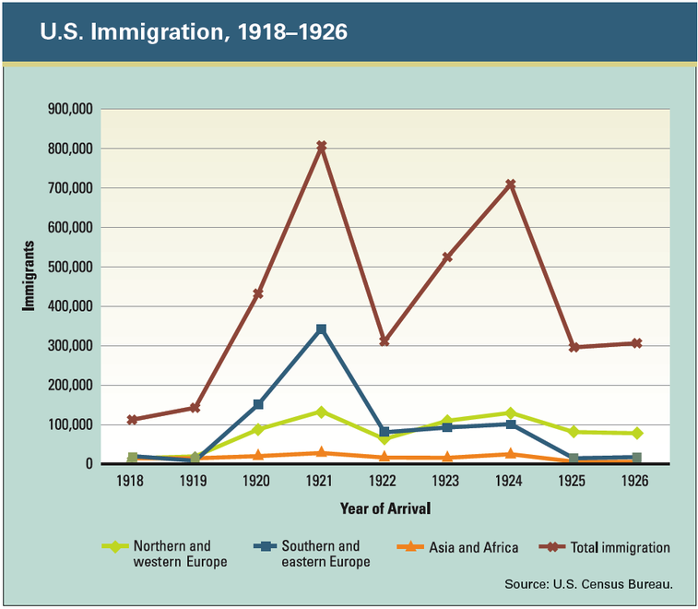
Notice the two big dips in this graph. The first one follows passage of the Emergency Immigration Act of 1921. The second shows the impact of the Immigration Act of 1924.

Slide 19
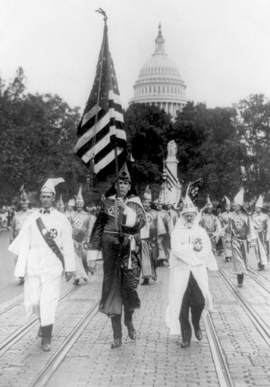
The first Ku Klux Klan arose during Recon­struction to intimidate freedmen. It faded away after Reconstruction but was reborn in 1915. This new KKK targeted African Americans, immigrants, Jews, Catholics, and anyone with values that Klan members saw as “un-American.” Klan membership swelled to 3-4 million members and gained considerable political power throughout the country. The KKK portrayed itself as a defender of American values.

Slide 20
What was ROARING in post-World War I America in the 1920s?
“The return to normalcy ushered in an exciting new era, including the start of the automobile culture, flappers and the revolution in manners and morals. The consumer revolution, the rise of advertising and motion pictures, the Harlem Renaissance, the Jazz Age and the golden age of sports were all glamorous new aspects of American life. Meanwhile, social polarization, prohibition, the Scopes Trial and the rebirth of the KKK represented the more sober social realities.”

Slide 21
The Roaring 1920s
nativist Harlem Renaissance flight revival pivotal jazz sports temperance
The motion picture industry was born and quickly assumed a role in American culture. Americans were also entertained by music, just one aspect of the emergence of a distinctively African-American culture, known as the . Heroes from the “Golden Age of ” led by Babe Ruth and Jack Dempsey excited many, and Charles Lindbergh thrilled the world with his daring . However, old social tensions flared up during this period of rapid cultural change. advocates had succeeded in making Prohibition the law of the land, but enforcement proved very difficult. The Ku Klux Klan experienced a strong , expressing hatred towards those they regarded as un-American, and groups rejected many elements of the new culture that they believed were destroying American values.
pivotal
jazz
Harlem Renaissance
sports
flight
Temperance
revival
nativist

Slide 22
The Roaring 1920s
gap prosperity stocks production
The excitement generated by the economic of the time tended to overshadow underlying weaknesses such as high speculation in , cutbacks in industrial and the increasing between rich and poor. The causes for an abrupt end to the economic optimism of the Roaring Twenties were in place.
“Nothing in the world can take the place of persistence. Talent will not; nothing is more common than unsuccessful men with talent. Genius will not; unrewarded genius is almost a proverb. Education will not; the world is full of educated derelicts. Persistence and determination are omnipotent. The slogan 'press on' has solved and always will solve the problems of the human race.”
- Calvin Coolidge
prosperity
stocks
production
gap

Slide 23
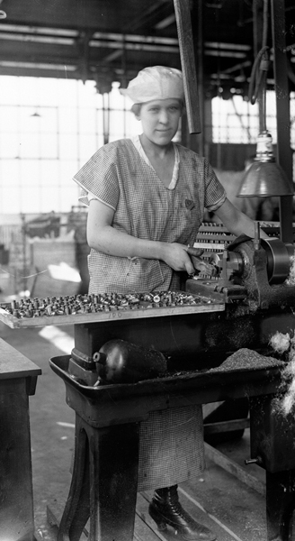
As soon as World War I ended, the federal government canceled its contracts with weapons manufacturers, like this one in New Jersey. Hundreds of thousands of factory workers were laid off. At the same time, the army released nearly 4 million soldiers. The result was massive unemployment and an economic recession. Like many workers after World War I, Sacco and Vanzetti were union men. A poorly planned demobilization resulted in an economic recession after World War I. As unemployment rose, living standards for all but the richest Americans declined.

Slide 24
Vocabulary
Progressivism — An American reform movement within both major political parties, from about 1890 to World War I, that pressed for legislation to reform many aspects of America’s urban and industrial systems.
“The Jazz Age” and “The Roaring Twenties” — Terms used by historians to characterize the decade of the 1920s.
Third Industrial Revolution — The shift in the 1920s towards relying on electricity for power and utilizing the assembly line for the mass production of consumer goods.
Model T— A reliable, affordable car that was designed, manufactured and sold by Henry Ford. It became one of the most popular American-made cars in history.
mass consumer culture — The desire of producers to sell, and of consumers to buy, the many new products developed in the 1920s, such as electrical appliances.
19th Amendment — The Constitutional amendment that gave women the right to vote.
Speakeasies — Places where alcoholic drinks were sold illegally during the time of Prohibition.
Flappers — Young women of the 1920s who sought to liberate themselves from old social rules and customs and to enjoy life fully and on a basis equal with men.
snake oil salesmen — A term used to describe dishonest salesmen in traveling medical shows or in country fairs, who sold bottles filled with worthless mixtures as medicinal cures.

Slide 25
Vocabulary
Prohibition — A time in American history, following the passage of the 18th Amendment, when it was illegal to produce, transport or consume alcoholic beverages.
Ku Klux Klan — A secret terror organization dedicated to white supremacy, first organized in the South after the Civil War.
nativism — A postwar phenomenon characterized by Americans’ distrust of foreigners and foreign influence.
“Golden Age of Sports” — A time in the 1920s when sports became tremendously popular and top athletes like Babe Ruth, Jack Dempsey, Bill Tilden, and Red Grange became sports heroes.
Scopes trial — A controversial trial in which John Scopes, a high school teacher, was convicted of breaking a Tennessee law outlawing the teaching of evolution.
The Gospel of Business — During the boom of the 1920s, the strong belief in American corporations and prosperity, best expressed by President Calvin Coolidge, that “The chief business of the American people is business.”

Slide 26
Alive! 26 - Understanding Postwar Tensions
Rising economic, political, and social tensions marked the years just after World War I. This tense atmosphere affected the murder trial of Nicola Sacco and Bartolomeo Vanzetti. Both men were sentenced to death, despite weak evidence. Some Americans saw Sacco and Vanzetti as victims of prejudice against immigrants and radicals.
Recession A poorly planned demobilization resulted in an economic recession after World War I. As unemployment rose, living standards for all but the richest Americans declined.
Labor unrest Unions staged thousands of strikes for better wages and working conditions. Despite these efforts, unions began to lose strength, and their membership declined.
Red Scare Fear of socialists, communists, and anarchists fueled the Red Scare. Attorney General Mitchell Palmer led raids against suspected subversives, often violating their civil liberties.
Immigration restriction Congress responded to anti-immigrant pressure by restricting immigration. A quota system also limited the number of immigrants from each country.
Back-to-Africa movement African Americans were disappointed that their service to the country in World War I did not reduce racial prejudice. Marcus Garvey's Back-to-Africa movement appealed to blacks who had given up hope for equality in the United States.
Discrimination Nativism surged in the postwar years. A revived Ku Klux Klan targeted blacks, immigrants, Jews, and Catholics as un-American. The Anti-Defamation League began in response to anti-Semitism. The American Civil Liberties Union formed to protect freedom of speech.

Slide 27
Alive! 27 - The Politics of Normalcy
The election of 1920 launched a decade-long Republican Era in national politics. During that time, three Republican presidents—Warren G. Harding, Calvin Coolidge, and Herbert Hoover—worked to return the nation to "normalcy," or peace and prosperity.
Isolationism After World War I, many Americans favored a policy of isolationism, or withdrawal from international affairs.
Free enterprise system The Republican presidents supported individual enterprise and the free enterprise system by adopting business-friendly fiscal policies. The government cut taxes and spending.
Teapot Dome Scandal The Harding administration was marred by corruption. Harding's distress over the Teapot Dome Scandal contributed to his declining health. He died in office in 1923.
Washington Naval Conference The Republican presidents turned to diplomacy to prevent another world war. The Washington Naval Conference attempted to reduce military competition by limiting the size of the world's most powerful navies.
Kellogg-Briand Pact Sixty-two nations signed this treaty, in which they agreed to outlaw war.
Dawes Plan The United States set up the Dawes Plan to help European nations pay their war debts to American lenders.
Dow Jones Industrial Average Americans hoping to "get rich quick" engaged in speculation in land and stocks. The Dow Jones Industrial Average rose as money flowed into the stock market.
Economic boom The economy prospered as businesses boomed. Business consolidation led to the domination of most major industries by just a few companies. However, poverty persisted, and many farmers and workers were left out of the boom.

Slide 28
Alive! 28 - Popular Culture in the Roaring Twenties
New ideas and prosperity brought change to American popular culture in the Roaring Twenties. The creative energy of writers, artists, filmmakers, and musicians, as well as innovations by businesspeople and inventors, all contributed to new directions in American life.
Consumer culture New products and advertising encouraged a buying spree. Credit and installment buying allowed people to buy now and pay later.
Mass media National magazines, radio, and motion pictures brought news, information, and entertainment to millions of Americans. Regional differences began to fade as a new national popular culture became part of daily life.
Women voters All women gained the vote in 1920. The League of Women Voters encouraged all voters to become informed about public issues. Congress considered, but rejected, the first version of the equal rights amendment.
The Jazz Age Jazz, a new form of music, expressed the mood of the decade. Introduced by African American musicians, jazz became popular throughout the country and the world.
Harlem Renaissance Musicians and writers centered in Harlem gave voice to the experiences of African Americans in song, poetry, and novels.
Lost Generation Disillusioned by World War I and the nation's growing consumer culture, some artists and writers fled to Paris. This "Lost Generation" produced books and poetry that are still read and enjoyed today.
Spectator sports More leisure time allowed Americans to attend sporting events. Spectator sports became a big business, and athletes became national celebrities.

Slide 29
Alive! 29 - The Clash Between Traditionalism and Modernism
Culturally, the United States became a deeply divided nation during the Roaring Twenties. Tensions arose between traditionalists, with their deep respect for long-held cultural and religious values, and modernists, who embraced new ideas, styles, and social trends.
Urban versus rural By 1920, the United States was becoming more urban than rural. Urban areas prospered as business and industry boomed. Rural areas declined economically and in population.
Youth versus adults Suspicious of the older generation after the war, many young people rejected traditional values and embraced a new youth culture. Chaperoned courting gave way to unsupervised dating. Flappers scandalized the older generation with their style of dress, drinking, and smoking.
Wets versus drys The Eighteenth Amendment launched the social experiment known as prohibition. The Volstead Act, which outlawed the sale of alcohol, was supported by drys and ignored by wets. The Twenty-First Amendment repealed prohibition in 1933.
Religion versus science Religious fundamentalists worked to keep the scientific theory of evolution out of public schools. The Scopes trial, testing Tennessee's anti-evolution law, was a legal victory for fundamentalists but a defeat in the court of public opinion. The issue of teaching creationism in biology classes is still current today.

Slide 30
“The Great Depression & New Deal”
“This program explores the causes of the Great Depression and the impact of the stock market crash as hard times fell on America. It also covers the New Deal, the Dust Bowl and the newly emerging culture of sight and sound. As the New Deal came under fire, the Second New Deal was issued, the Wagner Labor Act was passed, the unions gained power and a modern welfare state was born.”
2nd of 5 skills-based district exams…final average is 10% of your grade for US History II!
Notes:
Period 2: ended on Monday 1-12; Period 3: needs to start here Tuesday

Slide 31
“The Great Depression & New Deal”
The prosperity of the Roaring Twenties ended as the Stock Market Crash of 1929 ushered in one of the worst economic depressions in history. Although the causes of the Great Depression were clear to many, solutions to problems such as high unemployment and extreme poverty proved to be elusive. President Herbert Hoover tried to alleviate some of the suffering, but his traditional methods did nothing to improve economic conditions. The 1932 presidential election brought Franklin D. Roosevelt to the White House. He promised a “New Deal” to the American people and embarked on a course to restore confidence in the nation’s financial system and to get people back to work. The programs of the Roosevelt administration sought to bring relief to all segments of the economy and were quickly passed by Congress. President Roosevelt’s “fireside chats” convinced the American people he was on their side and First Lady Eleanor Roosevelt became known as a tireless advocate of the poor and downtrodden.

Slide 32
Time Line
1920s — The United States enjoys an unprecedented economic boom.
1928 — Herbert Hoover is elected president.
1929 — The stock market collapses.
1931 — Several unemployed men are killed in protests at Ford’s River Rouge plant.
1932 — The unemployment rate in the United States reaches approximately 25%.
1932 — Franklin Delano Roosevelt is elected president.
1933 — The first New Deal legislation begins to be enacted.
1934 — Great Plains dust storms blow soil as far east as Washington, D.C.
1934 — The Supreme Court rules the National Industrial Recovery Act unconstitutional.
1935 — The second New Deal begins.
1935 — The Social Security Act is signed into law.
1936 — President Roosevelt is reelected.
1938 — Congress authorizes federal deficit spending to stimulate the struggling economy.
1940 — President Roosevelt is elected to an unprecedented third term.

Slide 33
Vocabulary
Roaring Twenties — A term used to describe the economic boom of the 1920s.
Stock market crash (1929) — The precipitous decline of the stock market on October 29, 1929 that ushered in one of the worst economic depressions in history.
Great Depression — The time period from around 1929 to 1939 in which many people suffered from extreme poverty as a result of high unemployment.
Hoovervilles — A derogatory name given to Depression-era shacks where poor people lived when Herbert
Hoover was president.
trickle down theory — An economic theory that states when taxes are cut for business owners, money will
eventually trickle down to the poor in the form of new jobs.
Reconstruction Finance Corporation (RFC) — A U.S. Government Agency formed by Congress to give
financial aid to banks and businesses and to support public works projects during the Depression.
first New Deal — Name given to the set of laws initiated by President Roosevelt in 1933 and 1934 to fight the Depression.
National Industrial Recovery Act (NIRA) — The first of the New Deal measures enacted to help businesses
recover from the Depression. The Act created a new administrative bureau called the National Recovery Administration, or NRA.
Dust Bowl — The calamitous soil erosion caused by the removal of grasslands and severe droughts that ruined many farms and farmers in the Great Plains in the 1930s.
Agricultural Adjustment Administration — A government agency formed during the New Deal to give aid
to struggling farmers.
Civilian Conservation Corps (CCC) — A New Deal agency formed to put young unemployed men to work
on federal conservation projects.
Works Progress Administration (WPA) — A New Deal agency formed to put the unemployed to work on
federal projects.

Slide 34
Ch. 30 - The Causes of the Great Depression What caused the most severe economic crisis in American history?
The Great Depression was triggered by the stock market crash of 1929, but many other causes contributed to what became the worst economic crisis in U.S. history.
The stock market crash The stock market crash cost investors millions of dollars and contributed to bank failures and industry bankruptcies.
The financial crisis Banks made risky loans and investments in the 1920s. Some banks had to shut down when the economy collapsed, and many depositors lost their savings.
An unequal distribution of wealth The concentration of money in the hands of a few left most wage earners unable to buy all of the goods businesses were producing.
Underconsumption For a time, many consumers used credit, rather than cash, to buy such goods as cars and radios. When their level of debt grew too high, people stopped buying new products. The result was underconsumption of factory goods.
Overproduction American businesses produced more goods than people wanted or could afford. Eventually, factories had to close and workers lost their jobs.
Tight money supply After the stock market crash, Federal Reserve officials allowed the money supply to shrink. As the amount of money in circulation fell, economic activity decreased. This made it more difficult for businesses to produce and consumers to spend.
Rising interest rates After the stock market crash, Federal Reserve officials raised interest rates, making loans more expensive and limiting the amount of money in circulation. This made it more difficult for businesses to produce and consumers to spend.
Decline of international trade High import tariffs and collapsing European economies restricted international trade and deepened the Depression.

Slide 35
Ch. 31 - The Response to the Economic Collapse How did the government respond to the collapse that began in 1929?
Americans were anything but united in their responses to the Great Depression. Each group’s political ideology shaped its approach. The election of 1932 presented voters with a choice between Republican president Herbert Hoover’s conservative approach and Democratic challenger Franklin Roosevelt’s promise of a New Deal.
The conservative response Conservatives thought the government should leave the economy alone. They believed that the economy would eventually stabilize itself.
The liberal response Liberals thought the government should play a more active role in the economy. They also believed the government should step in to help those in need.
The radical response Radicals advocated abolishing the free enterprise system. They believed that the government should plan economic activity and distribute wealth according to need.
Herbert Hoover At first, President Hoover relied on voluntary cooperation to ease the Depression’s effects. As conditions worsened, Hoover gave government a limited role in the economy. His Reconstruction Finance Corporation, however, failed to revive the economy.
Franklin D. Roosevelt After his landslide victory in 1932, Roosevelt presented Congress with a variety of New Deal measures. During the First Hundred Days of his administration, Congress enacted many programs to provide relief, promote recovery, and enact reforms.

Slide 36
Ch. 33 - The New Deal and Its Legacy How did the expansion of government during the New Deal affect the nation?
Franklin D. Roosevelt promoted his New Deal policies to end the Great Depression and help needy Americans. The early programs of the First New Deal emphasized economic recovery and financial reform. The Second New Deal focused more on economic relief and social reform. These programs greatly expanded the role of the federal government in American life.
National Industrial Recovery Act The NIRA was aimed at shoring up the free enterprise system by helping businesses, workers, and the needy.
Agricultural Adjustment Administration The AAA sought to boost agricultural prices by paying farmers to plant fewer crops, thus reducing supply and increasing demand.
Wagner Act This law strengthened the labor movement by supporting the right of workers to organize and join unions.
Works Progress Administration The WPA organized and funded public works projects that provided jobs and wages to unemployed workers.
Social Security Act Social Security was designed to provide economic security to unemployed and retired Americans. It is a key legacy of the New Deal.
New Deal Coalition A diverse group of Americans came together to support FDR and the New Deal. This coalition helped insure FDR’s reelection and the continuation of his programs.

Slide 37
Unit III: 1920s, Great Depression, and New Deal
Enduring Understandings Students will understand that…
Cultural patterns established between the world wars are still today.
Conflict occurs when people perceive that values and culture are threatened by modern .
Economic excess and the unequal distributions of wealth can lead to in society.
Liberals and Conservatives have different beliefs about individual and the proper role of the
As a result of the New Deal, the United States government took on responsibilities for promoting the general .
relevant
traditional
changes
instability
responsibility
government
greater
welfare

Slide 38
EQ #1: What happens when traditional and modern cultures interact?
The clash between traditional moral values and changing ideas were exemplified in the controversy over Prohibition, the Scopes trial, and the emergence of the “New Woman.”
Rising tensions including, the resurgence of the Ku Klux Klan, and the rise of socialism/communism.
How different forms of mass media created consumerism and mass culture.
Contributions of artists and writers of the Harlem Renaissance

Slide 39
EQ #2: What influences do economic excesses have on American society?
Impact of the economic policies of the Harding and Coolidge administrations on wealth distribution, investment, and taxes.
Basic operation of the stock market.
Causes and consequences of the Great Depression and Dust Bowl.

Slide 40
EQ #3: What is the proper role of the government in people’s lives?
Effectiveness of presidential responses of the Hoover and Roosevelt administrations.
Opponents of New Deal policies and their arguments.

Slide 41
EQ #4: Did America move closer to or further away from its founding ideals during the interwar period?
How the ideals of liberty, equality, opportunity, rights and democracy were exemplified or contradicted during this time period.
FYI Acadmeic ONLY: This unit marks the end of the “window of time” that you will WRITE about for your midterm essay (5% of your final grade earned on Friday, January 23)
Organizer and prompt coming soon!

Slide 42
Ch. 12: Politics of the Roaring Twenties (p. 410-431)
History Alive!
Ch. 26 (p. 330-341)
Understanding Postwar Tensions
Ch. 27 (p. 342-351)
The Politics of Normalcy

Slide 43
demobilization recession radicalism Palmer Raids
demobilization: the act of discharging forces from military service or use
recession: period in which there is a decline in economic activity & prosperity
radicalism: a point of view favoring extreme change, especially in social or economic structure
Palmer Raids: conducted by Justice Department attorney J. Edgar Hoover at the instruction of U.S. Attorney General Mitchell Palmer, a series of unauthorized raids on homes, businesses, and meeting places of suspected subversives that resulted in the arrest of 6,000 radicals, often without any evidence against them.

Slide 44
quota system normalcy fiscal policy speculators
quota system: established by the Emergency Immigration Act of 1921, a system limiting immigration to the United States by permitting no more immigrants from a country than 3 percent of the number of that country's residents living in the United States in 1910; the Immigration Act of 1924 reduced the quota to 2 percent of the number of a country's residents living in the United States in 1890
normalcy: the concept of life as it was before World War I, when the nation could focus on its own domestic prosperity, which Republican candidate Warren G. Harding promoted during the 1920 presidential election campaign and which helped him win the presidency] ."
fiscal policy: the approach of a government to taxes and government spending
speculators: a person who takes the risk of buying something in the hope of reselling it for a higher price

Slide 45
A PERSONAL VOICE A. MITCHELL PALMER
“ The blaze of revolution was sweeping over every American institution of law and order . . . . eating its way into the homes of the American workman, its sharp tongues of revolutionary heat . . . licking the altars of the churches, leaping into the belfry of the school bell, crawling into the sacred corners of American homes, . . . Burning up the foundations of society.”
—“The Case Against the Reds”

Slide 46
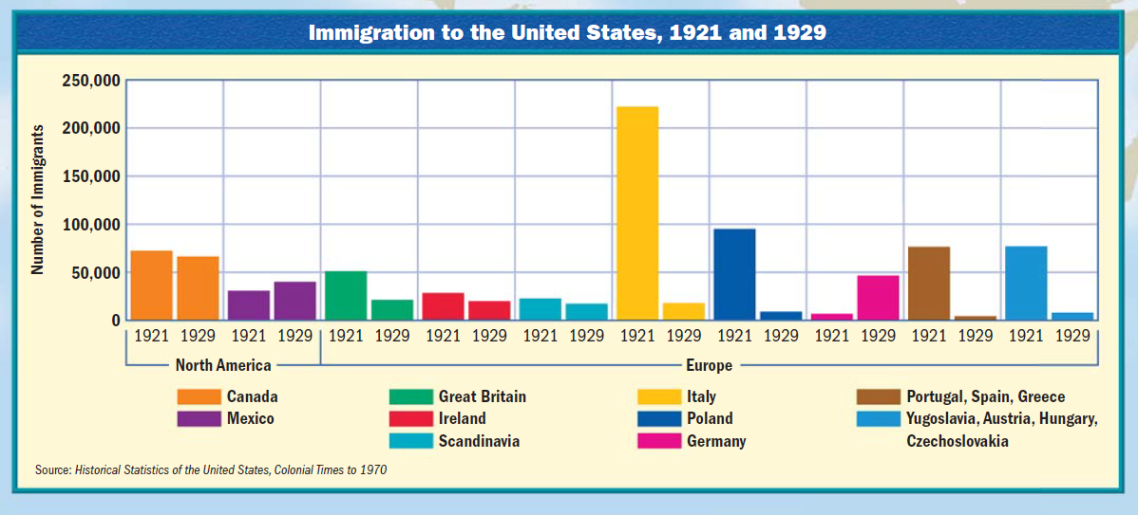
Interpret this graph…
…using several of the following:
nativism •isolationism •communism
•anarchists •Sacco and Vanzetti •quota system

Slide 48
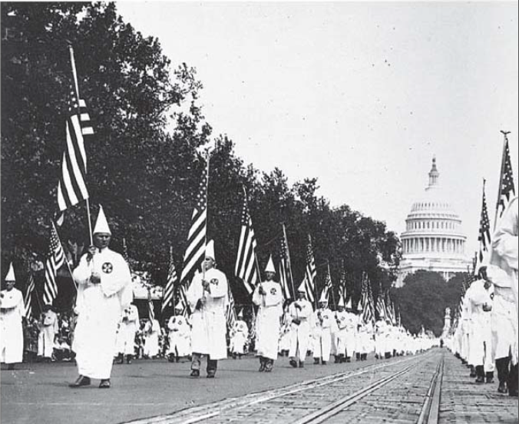
When I say (or you see)… you say (think of)???

Slide 49
Fact or Fiction?
“The KKK was devoted to “100 percent Americanism.” By 1924, KKK membership reached 1.5 million “white male persons, native-born gentile citizens.”
FICTION: It was 4.5 MILLION!!!
The Klan also believed in keeping blacks “in their place,” destroying saloons, opposing unions, and driving Roman Catholics, Jews, and foreign-born people out of the country.
FACT!

Slide 50
The Americans, Sec. 3
The new president, Calvin Coolidge, fit into the pro-business spirit of the 1920s very well. It was he who said, “the chief business of the American people is ?????.
business
“. . . The man who builds a factory builds a temple—the man who works there worships there.” Both Coolidge and his Republican successor, ????? , favored government policies that would keep taxes ????? and business profits up, and give businesses more available ????? in order to expand.
Herbert Hoover
down (low)
credit ($$)
Coolidge & Hoover’s goal was maximize government interference in business in order to allow private enterprise to flourish. FACT or FICTION?
FICTION: Their goal was to keep government interference in business to a minimum and to allow private enterprise to flourish.
Coolidge’s administration continued to place high tariffs on foreign imports, which helped American manufacturers. At the same time, wages were rising because of new technology, and so was productivity. FACT or FICTION?
FACT

Slide 51
Ch. 13 The Roaring Life of the 1920s (p. 432-461)
History Alive!
Ch. 28 (p. 353-367)
Popular Culture in the Roaring Twenties
Ch. 29 (p. 369-379)
Clash Between Traditionalism & Modernism

Slide 52
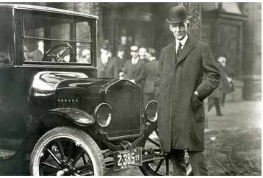
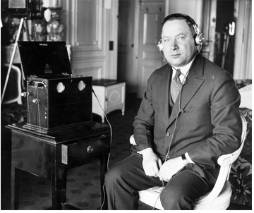
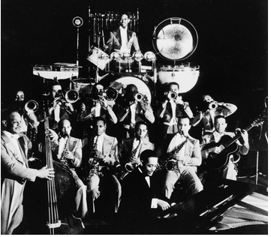
What 3 “things” made the 1920s a “ROARING” era?
Henry Ford inspired America’s love affair with the automobile. In the 1920s, Ford’s Model T’s were plain but affordable. When other manufacturers began to produce better-looking cars, Ford stopped making the Model T and instead made the Model A—another great success.
economic prosperity
technological advances
cultural boom
David Sarnoff was a leader in the growth of radio and television. He pioneered the development of radio programming, bringing news, music, tears, and laughter into homes across the nation.
Duke Ellington, shown here at the piano, was known for his good looks and elegance, as well as for his brilliant music. His band played at the Cotton Club for four years straight. “I am not playing ‘jazz,’” he once told an interviewer. “I am trying to play the natural feelings of a people.”
Notes:
Period 4 did this Wednesday, 1/29; Period 6 did this 1/29; Period 1 did this 1/30

Slide 53
traditionalist modernist fundamentalism popular culture
traditionalist: a person who has deep respect for long-held cultural and religious values
modernist: a person who embraces new ideas, styles, and social trends
fundamentalism: the belief that scripture should be read as the literal word of God and followed without question
popular culture: the culture of ordinary people, including music, visual art, literature, and entertainment, that is shaped by industries that spread information and ideas, especially the mass media
Notes:
Period 1 1/30

Slide 54
Volstead Act speakeasy consumer culture speculators
Volstead Act: a law passed by Congress in 1919 to enforce the Eighteenth Amendment, which prohibited the manufacture and sale of alcoholic beverages
speakeasy: a secret club that sold alcohol during the era of prohibition
consumer culture: a culture that views the consumption of large quantities of goods as beneficial to the economy and a source of personal happiness
speculators: a person who takes the risk of buying something in the hope of reselling it for a higher price

Slide 55
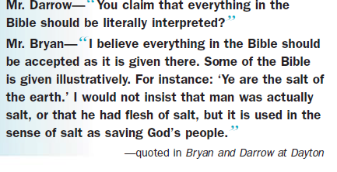
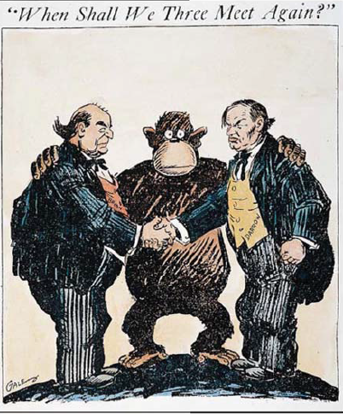
A PERSONAL VOICE Clarence Darrow & William Jennings Bryan
Scopes trial: a criminal trial, held in Dayton, Ohio, in 1925, that tested the constitutionality of a Tennessee law that banned the teaching of Darwin's theory of evolution in schools; science teacher John Scopes was found guilty and fined for his conduct, leaving the Tennessee law intact
Notes:
Period 1 ended here; Period 3 did NOT see most of these slides (Miley on Friday?); Period 5 discussed NONE of the slides past this point (not these one either)

Slide 56
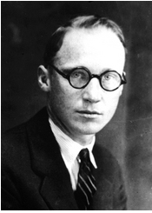
John Scopes did not testify during his trial for violating Tennessee’s anti-evolution law. But after being found guilty, he addressed the judge: “Your honor, I feel I have been con­victed of violating an unjust statute. I will continue in the future, as I have in the past, to oppose this law in any way I can. Any other action would be in violation of my idea of academic freedom —that is, to teach the truth as guaranteed in our Constitution.”

Slide 57
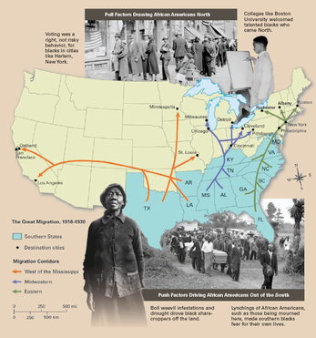
THE MOVE NORTH
Between 1910 and 1920, in a movement known as the Great Migration, hundreds of thousands of African Americans had uprooted themselves from their homes in the South and moved north to the big cities in search of (industrial) jobs. By the end of the decade, 5.2 million of the nation’s 12 million African Americans—over 40 percent—lived in cities.

Slide 58
What is this (BELOW) and how does it relates to the Harlem Renaissance?
I've known rivers: I've known rivers ancient as the world and older than the flow of human blood in human veins. My soul has grown deep like the rivers.
I bathed in the Euphrates when dawns were young. I built my hut near the Congo and it lulled me to sleep. I looked upon the Nile and raised the pyramids above it. I heard the singing of the Mississippi when Abe Lincoln went down to New Orleans, and I've seen its muddy bosom turn all golden in the sunset.
I've known rivers: Ancient, dusky rivers. My soul has grown deep like the rivers.
What kind of metaphor, symbol, or image related to life for African-Americans can be found in the poem?
—Langston Hughes, "The Negro Speaks of Rivers," 1920
Langston Hughes wrote poetry, plays, and fiction that captured the anguish of African Americans' longing for equality. He composed one of his best-known poems while traveling to New York at the age of 17.
Notes:
Period 1 examined this 1/30; Period 4 & 6 stopped here (saw it-didn’t discuss it?)

Slide 59
The Americans, Ch. 13, Sec. 4
Many African Americans who migrated north moved to Harlem, a neighborhood on the Upper West Side of ?????. In the 1920s, Harlem became the world’s largest black urban community, with residents from the South, the West Indies, Cuba, Puerto Rico, and Haiti. James Weldon Johnson described Harlem as the capital of black America.
New York’s Manhattan Island
Like many other urban neighborhoods, Harlem suffered from ?????, ?????, ?????, but its problems in the 1920s were eclipsed by a flowering of creativity called the Harlem Renaissance, a literary and artistic movement celebrating ????? culture.
overcrowding, unemployment, and poverty
African-American
The Harlem Renaissance provided a foundation of African-American intellectualism to which African-American writers, artists, and musicians contribute today. FACT or FICTION?
FACT

Slide 60
Ch. 14: The Great Depression (p. 462-485)
History Alive!
Ch. 30 (p. 382-391)
The Causes of the Great Depression
Ch. 31 (p. 392-399)
The Response to the Economic Collapse
Ch. 32 (p. 400-411)
Human Impact of the Great Depression

Slide 61
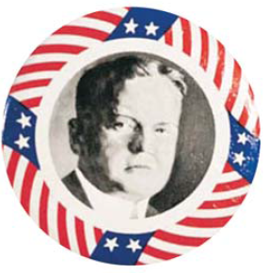
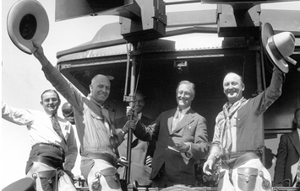
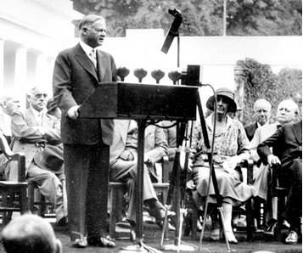
Who am I?
What do you remember about me & my presidency?
“ We in America are nearer to the final triumph over poverty than ever before. ”
In 1932, Franklin Roosevelt (Democrat, 1932-1944) launched an ambitious campaign tour of the country by train. At each stop, bands played his cheerful campaign song, “Happy Days Are Here Again.” To the attendees, Roosevelt gave compelling speeches that he carefully planned with the help of a group of advisors nicknamed the Brain Trust.
Herbert Hoover had no plans to get out and campaign in 1932. A sitting president typically ran a “front porch” campaign, leaving the White House for only a speech or two. However, as Hoover’s troubles mounted, he could not remain idle. By early October, he decided to take to the road in a campaign tour that included about 200 speeches.
HERBERT HOOVER
(Republican, 1929-1932)
Notes:
Period 3 saw NONE of these slides

Slide 62
buying on margin broker bull vs. bear market overproduction “vs.” underconsumption
buying on margin: buying stock by paying a percentage of a stock's price and borrowing the rest of the money from a broker, allowing one to make greater profits if the stock does well
broker: a person who buys and sells stocks for clients
bull market: a period in which stock prices are steadily rising bear market: a period in which stock prices are steadily decreasing
overproduction: a situation in which more goods are being produced than people can afford to buy underconsumption: a situation in which people are purchasing fewer goods than the economy is producing
Notes:
Period 6 ended here on Friday

Slide 63
conservative vs. liberal
conservative: someone who cherishes and seeks to preserve traditional customs and values;
conservatives in the 1930s valued included self-reliance, individual responsibility, and personal liberty. Conservatives tend to prefer the status quo, or current conditions, to abrupt changes.
They accept change, but only in moderation. Depression-era conservatives opposed large governmental efforts to effect change, which they felt challenged their values.
liberal: someone committed to the expansion of liberty;
By the start of the Progressive Era, many liberals believed that the government should play a role in regulating economic affairs.
As the Depression set in, liberals looked to the government to expand its powers once again to protect individual liberty. However, now they defined liberty as freedom from hunger and poverty.
Notes:
Period 6 needs to see from here til the end

Slide 64
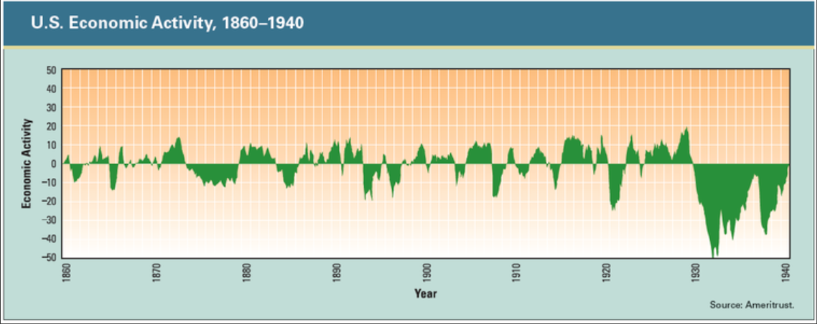
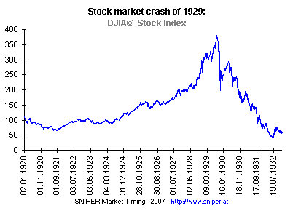
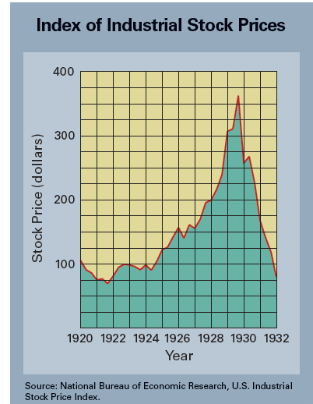
This graph shows how the business cycle repeats itself over time. The cycle begins with a period of economic expansion. In time, economic activity peaks, and then the business cycle moves into a period of decline. After the downturn reaches its lowest point, a new period of economic expansion begins.
As the graph to the right shows, the index of industrial stocks plunged between its peak in 1929 and 1932, losing nearly two thirds of its value. A stock index measures the performance of stock prices over time.
????????????????
INTERPRET any of these graphs
Notes:
Period 1 saw this…

Slide 65
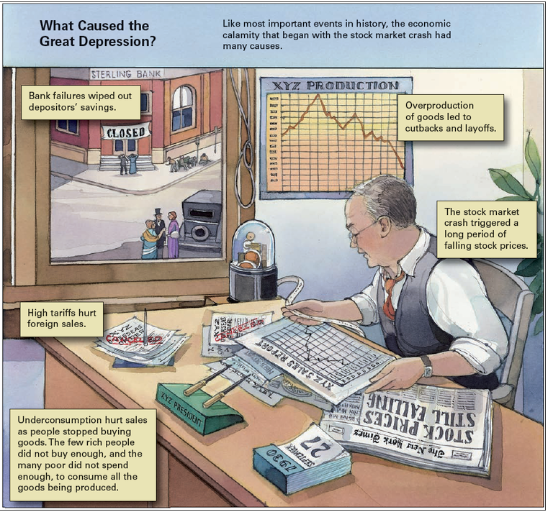
????
???????
????????
?????
??????????
Notes:
Period 5 saw this on Friday, 1/31

Slide 66
Fact or Fiction?
16 million
On October 29, 1929 over 6 million shares were “dumped” in a day, and by mid-November roughly $30 million dollars were lost in the stock market.
$30 billion
FICTION:
16 MILLION shares $30 BILLION lost!!!!

Slide 67
Which of these is FICTION?
CAUSES OF THE GREAT DEPRESSION
Although historians and economists differ on the main causes of the Great Depression, most cite a common set of factors, among them:
tariffs and war debt policies that cut down the foreign market for
American goods
a crisis in the farm sector
the availability of easy credit
equal distribution of income
These factors led to falling demand for consumer goods, even as newly mechanized factories produced more products. The federal government contributed to the crisis by keeping interest rates low, thereby allowing companies and individuals to borrow easily and build up large debts. Some of this borrowed money was used to buy the stocks that later led to the crash.
FICTION→equal distribution of income…UNEQUAL

Slide 68
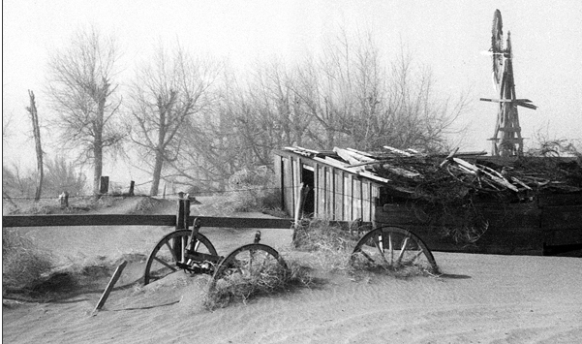
What is being described here?
The drought and winds of the DUST BOWL’s devastation lasted for more than seven years. The dust storms in Kansas, Colorado, New Mexico, Nebraska, the Dakotas, Oklahoma, and Texas were a great hardship—but only one of many—that Americans faced during the Great Depression.
In the 1930s, drought and windstorms turned much of the Great Plains into a “Dust Bowl.” Farmers watched helplessly as winds picked up precious topsoil and blew it away in massive dust clouds. The drought affected much more of the country than just the Dust Bowl, but this region suffered the most.

Slide 69
Ch. 15: The New Deal (p. 486-523)
History Alive!
Ch. 33 (p. 412-427)
The New Deal and its Legacy

Slide 70
THE HUNDRED DAYS Fact or Fiction?
On taking office, the Roosevelt administration launched a period of intense activity known as the Hundred Days, lasting from March 9 to June 16, 1932.
During this period, Congress passed 5 major pieces of New Deal legislation. These laws, and others that followed, significantly expanded the federal government’s role in the nation’s economy.
FICTION: 1933…won election of 1932 against Herbert Hoover with an overwhelming victory, capturing nearly 23 million votes to Hoover’s nearly 16 million.
FICTION: over 15 major new laws were passed!

Slide 71
Laissez-faire vs. deficit spending right wing vs. left wing New Deal Coalition welfare state
Laissez-faire: a policy that allows businesses to operate with very little interference from the government.
deficit spending: a government's practice of spending more money than it receives in revenue, the difference being made up by borrowing
right wing: the conservative side of the political spectrum
left wing: the liberal side of the political spectrum
New Deal Coalition: a political partnership formed during the 1930s among various social and political groups in support of the New Deal, the Democratic Party, and Franklin D. Roosevelt. Besides women and minority groups, the coalition included industrial workers, farmers, immigrants, reformers, southern whites, and city dwellers.
welfare state: a social system in which the government takes responsibility for the economic well being of its citizens by providing programs and direct assistance

Slide 72
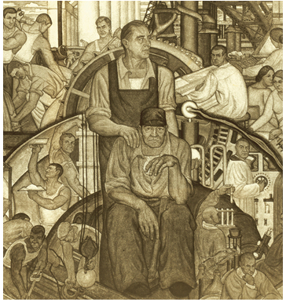
What are the three “R’s” of FDR’s New Deal?
Relief
Can you “see” or recall examples of programs or initiatives that demonstrate FDR’s goals for America?
Recovery
Reform

Slide 73
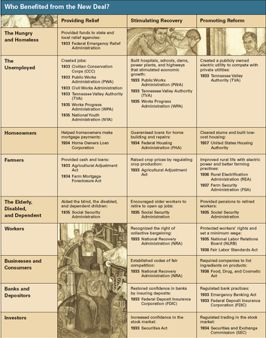
History Alive!, p. 424
Who benefitted from the New Deal?

Slide 76
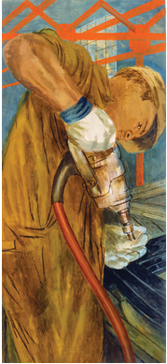
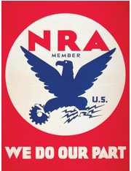
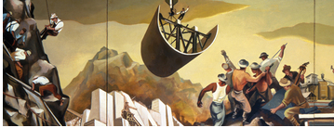
“What New Deal program am I?”
NIRA (NRA) AAA WPA CCC
-a law passed by Congress in 1933 to increase production while boosting wages and prices; it was the centerpiece of the New Deal’s efforts to breathe life into the economy. It was designed to increase production while boosting wages and prices. Its goals were to make more goods available and to give consumers more money with which to buy them.
NIRA created the National Recovery Administration (NRA) & targeted the needs of 3 groups:
To help business, the law set up the National Recovery Administration (NRA). This government agency worked with business leaders to create codes of fair competition in various industries. Each industry followed its own code, which required companies in that industry to standardize products, set minimum prices, and announce any expected price increases; This agency tried to aid farmers by reducing crop production and raising prices. Farmers had long suffered from low market prices for their products, which eroded their purchasing power—their ability to buy farm machinery and other goods. Many farmers also lost their farms because they were unable to pay their mortgages.
-a work-relief program established in 1933, as part of the First Hundred Days of the New Deal, to provide work for unemployed Americans during the Great Depression; which gave young men jobs planting trees and working on other projects typically involving natural preservation.
National Industrial Recovery Act
business, labor unions, and the unemployed
Civilian Conservation Corps

Slide 77
“What New Deal program am I?”
NIRA (NRA) AAA WPA CCC
-a federal agency created by Congress in 1933 to help reduce farmers' crop production and restore the prices of their goods to a reasonable level.
-a relief organization established in 1939 to provide work for unemployed Americans during the Great Depression. They built hundreds of thousands of bridges, public buildings, and parks. At the urging of Eleanor Roosevelt, it also established arts projects. It hired unemployed artists to paint murals in public buildings. Musicians combed the American backcountry to find and record folk music. Writers created guidebooks to the states.
Agricultural Adjustment Administration
Works Progress Administration

Slide 78
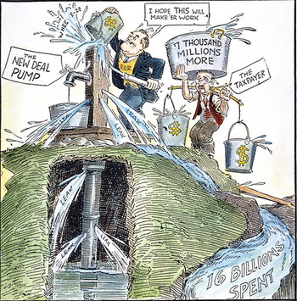
Although the First New Deal was popular with most Americans, it sparked criticism from both the left and the right. Critics on the right complained that much of the tax money being pumped into the economy by New Deal programs was being wasted. Critics on the left argued that the New Deal was not doing enough to help those in need.

Slide 79
What is your assessment of the New Deal & its lasting legacy?

