Slide 1
Decades of Change
GI Bill of Rights
Baby boom
Growth of the suburbs
Levittowns
1950s economy
Conformity
Role of women
Popular culture
Civil Rights movement
Brown v. Board of Education
Rosa Parks
Martin Luther King
civil disobedience
1963 March on Washington
Great Society
Women’s liberation movement
Vietnam War
Goal
Outcome
Soldiers’ experience
Military draft
Hawks vs. Doves
Watergate- legacy
Three Mile Island

Slide 2
Chapter 19 The Postwar Boom
1. What social, economic, and political changes
occurred after World War II?
Using the GI bill, millions of returning soldiers got an education and bought homes in the growing suburbs. By 1960, 1/3 of Americans lived in suburbs. After years of denial, consumers launched a spending spree that helped fuel an economic boom. Voters grew more conservative and Truman, who desegregated the armed forces & proposed a civil rights bill for African Americans decided not to run for re-election. Republican Dwight D. Eisenhower was elected to two terms.

Slide 3
Chapter 19 The Postwar Boom
2. What were the benefits and costs of prosperity in
the 1950s?
While many enjoyed prosperity in the 1950s, including more leisure time (TV, sports, camping, etc.), critics said that the new economy stifled individualism (led to conformity). Also, the new car culture, which gave freedom to travel and to live away from work, caused a decline in the inner cities and added pollution and traffic deaths to society’s woes. 40% of women worked outside the home by 1960.

Slide 4
Chapter 19 The Postwar Boom
3. Describe the values of 1950s popular culture and
the subcultures that arose in opposition.
Popular culture of the 1950s—spread largely through television but also through print media—deemphasized minorities and women. Idealized white America was portrayed with little reference to poverty, diversity, or conflicts, such as the civil rights movement. The counterculture criticized material values and conformity. The beat movement in literature and rock ‘n’ roll music clashed with the “tidy suburban view of life.”

Slide 5
Chapter 19 The Postwar Boom
4. What groups were not touched by the prosperity
of the 1950s?
Most African Americans, Hispanics, and Native Americans were denied a part in the prosperity of the 1950s. “White flight” increased the number of minorities who lived in dirty, crowded slums. “Urban renewal” involved tearing down rundown neighborhoods and constructing low-income housing.

Slide 6
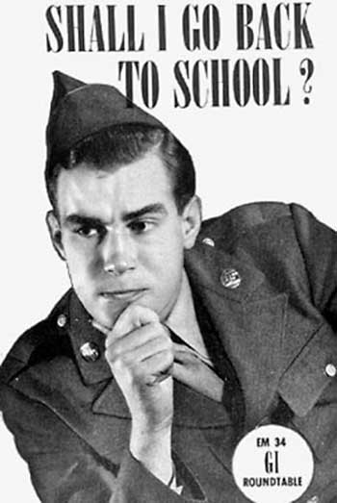
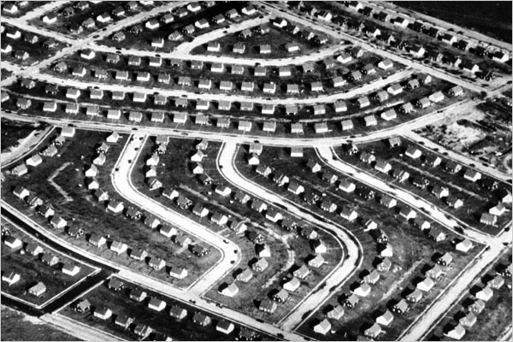
GI Bill of Rights Suburbanization
College, marriage, family, house, & job were common post-WW II goals
~1/3 of all Americans live in suburbs by 1960
  Economy was more robust (shift from wartime to peacetime was less problematic than anticipated)
  Cars and home construction led to increased prosperity for many
  conformity = suburban lifestyle house w/white-picket fence, 2-car garage…
  drastic increase in the number of children born (baby boom)
  women experienced greater economic independence during WW II
  society’s expectations limited the opportunities of women (stay at home?)
  greater divorce rate (more than a million by 1950)

Slide 7
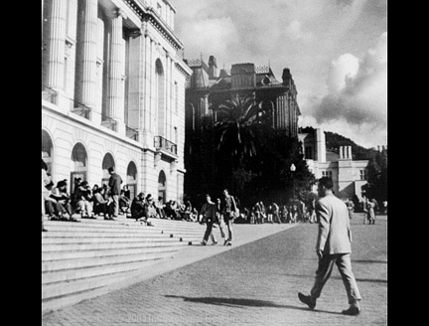
Servicemen’s Readjustment Act
To smooth the country's transition to peace after World War II, Congress passed the Servicemen's Readjustment Act of 1944. It was commonly known as the GI Bill of Rights. It provided assistance to returning service people, including low-interest home loans, and grants to pay college tuition. As a result, college enrollments skyrocketed. By the spring of 1949, nearly 26,000 students were attending U.C. Berkeley. By comparison, barely 17,000 had been enrolled in 1941. Such rapid growth took place in higher education institutions all through the state.
Wheeler Hall on the campus of the University of California, Berkeley, 1949.

Slide 8
GI Bill of Rights
shaped American society in the post WW II period for the better
college became a real option for many Americans
It allowed millions of Americans to achieve a standard of living that was generally better than that enjoyed by their parents

Slide 9
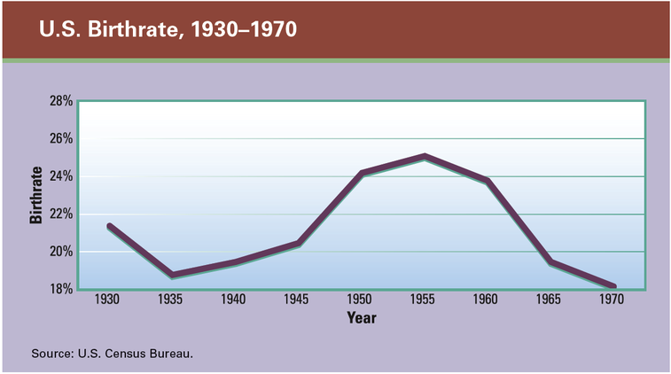
Baby Boom
The economic prosperity that followed World War II triggered a baby boom that peaked in 1957 (one baby every 7 seconds) and lasted until 1964. Then, almost as suddenly as it began, the boom ended. By 1966, the birthrate had dropped below the lowest level seen during the Depression years. In just two years, the baby boom had become a baby bust.

Slide 10
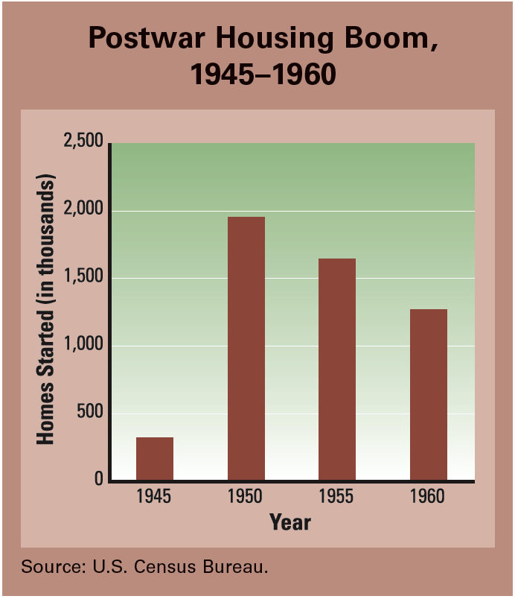
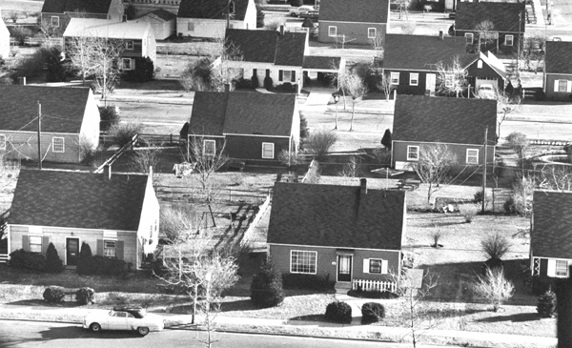
The first Levittown homes were just 800 square feet in size, but they came with an expandable attic. Buyers could choose from five models that differed in color, roofline, and window placement. Even the salesmen used assembly-line methods. A buyer could choose a house and sign a contract within three minutes.
The rapid growth in housing starts was made possible by a revolution in home construction techniques. Using assembly-line methods pioneered by Henry Ford, homebuilders like the Levitt brothers were able to mass-produce homes at an astonishing rate.
Suburbs

Slide 11
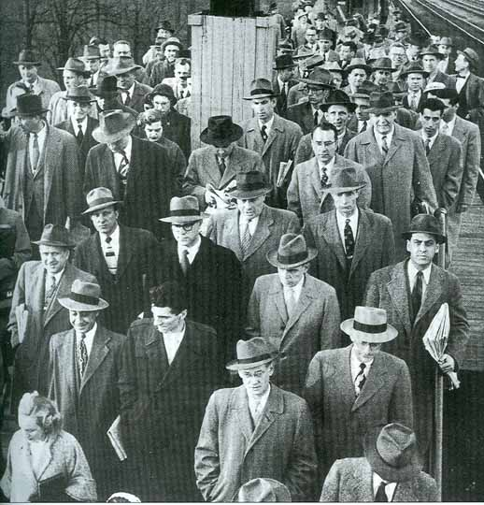
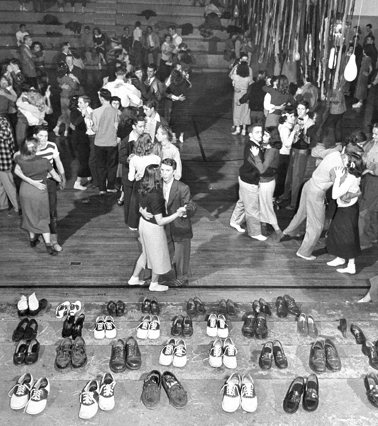
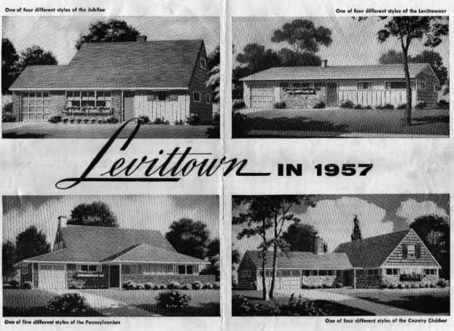
conformity: 1950s were a time when everyone behaved and thought in socially expected ways
Americans looked for normalcy & calm following Great Depression & WW II
Ideal family?
Father = breadwinner
Mother = stay at home, cook,
clean, etc.
Children = clean-cut, behaved & respectful, did chores
Similarity did NOT sit well with everyone…a counterculture movement develops as people resist the “sameness” of the 1950s ideals
http://libguides.wsulibs.wsu.edu/content.php?pid=109047&sid=820606

Slide 12
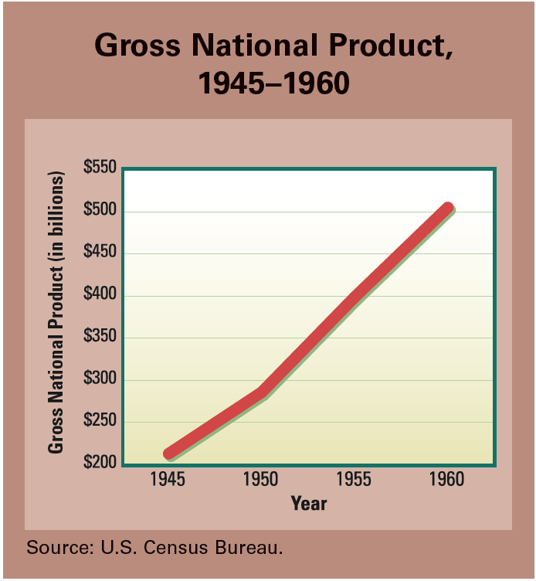
prosperity
At the end of World War II, many economists feared the economy would once again fall into a depression. Instead, consumer spending helped spur a long period of economic growth. The nation’s productivity more than doubled from 1945 to 1960.

Slide 13
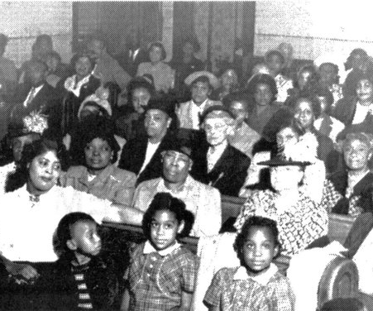
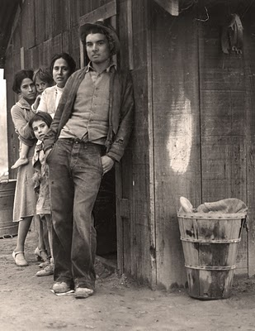
poverty
40 million “other” Americans lived in poverty & were not benefitting from the economic boom of the 1950s
Elderly people, single women & children, minority groups such as African-Americans, Latinos, and Native Americans
By 1962, 1 in 4 Americans were poor
Suburban growth took people, businesses, & tax money from urban centers…decay & poverty rose

Slide 14
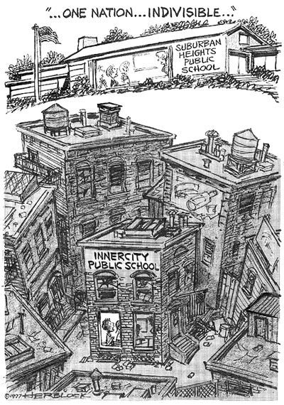
white flight
Large numbers of white citizens left cities and moved to suburbs in 1950s resulting in isolation from other races & classes
Between WW II and 1960, nearly 5 million African Americans moved from the rural South to urban areas
Cities lost businesses & property taxes, so schools, public transportation, fire, & police departments were underfunded
Urban poor suffered

Slide 15
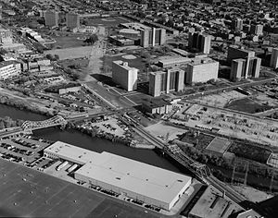
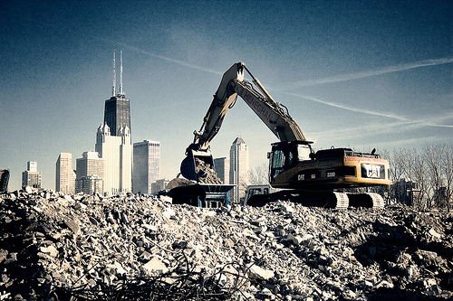
urban renewal
a program of land redevelopment in areas of moderate to high density urban land use (cities)
relocation of businesses, the demolition of structures, the relocation of people
less congestion when areas of cities receive freeways and expressways
Truman gained Congressional support for cities to clear out slums & build 810,000 housing units for low-income families

Slide 16
The African-American Civil Rights Movement
The African-American Civil Rights Movement (1955–1968) refers to the social movements in the United States aimed at outlawing racial discrimination against African Americans and restoring voting rights to them. The emergence of the Black Power Movement, which lasted roughly from 1966 to 1975, enlarged the aims of the Civil Rights Movement to include racial dignity, economic and political self-sufficiency, and freedom from oppression by white Americans.

Slide 17
The African-American Civil Rights Movement
The movement was characterized by major campaigns of civil resistance. Between 1955 and 1968, acts of nonviolent protest and civil disobedience produced crisis situations between activists and government authorities. Federal, state, and local governments, businesses, and communities often had to respond immediately to these situations that highlighted the inequities faced by African Americans. Forms of protest and/or civil disobedience included boycotts such as the successful Montgomery Bus Boycott (1955–1956) in Alabama; "sit-ins" such as the influential Greensboro sit-ins (1960) in North Carolina; marches, such as the Selma to Montgomery marches (1965) in Alabama; and a wide range of other nonviolent activities.

Slide 18
The African-American Civil Rights Movement
Noted legislative achievements during this phase of the Civil Rights Movement were passage of Civil Rights Act of 1964, that banned discrimination based on "race, color, religion, or national origin" in employment practices and public accommodations; the Voting Rights Act of 1965, that restored and protected voting rights; the Immigration and Nationality Services Act of 1965, that dramatically opened entry to the U.S. to immigrants other than traditional European groups; and the Fair Housing Act of 1968, that banned discrimination in the sale or rental of housing. African Americans re-entered politics in the South, and across the country young people were inspired to take action.

Slide 19
Thanks for your WORK!
Brown v. Board of Education (1954)
Alive! p. 574
Also read p. 568
Plessy v. Ferguson (1896)
p. 580-581
School Desegregation
What is segregation?
Martin Luther King Jr.
A Campaign in Birmingham
Alive! p. 584-586
Also read p. 586
Achieving Landmark Civil Rights Legislation
How far should the government go to promote equality and opportunity?
Rosa Parks & Montgomery Bus Boycott
Alive! p. 578-579
Also read p. 582-583
What is the difference between activism & civil disobedience?
John F. Kennedy
Ch. 48, The Age of Camelot
p. 625-637
Focus on:
Election and his administration
His cautious approach to civil rights
Tragic and controversial end to Camelot

Slide 20
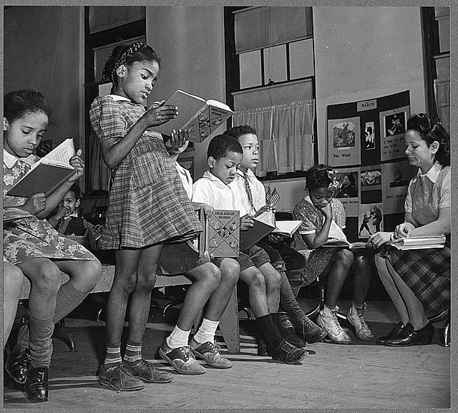
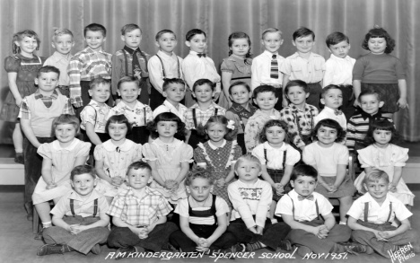
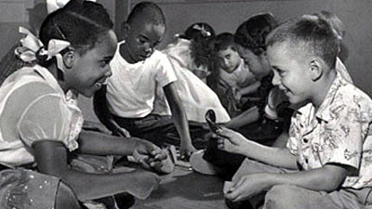
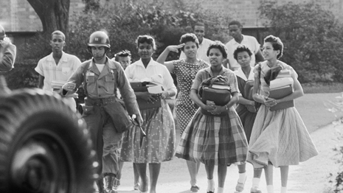
Brown v. Board of Education
Brown v. Board of Education (1954)
Class action lawsuit (set of cases) brought by the NAACP (National Association for the Advancement of Colored People) against the school board of Topeka, Kansas on behalf of the family of Linda Brown & 12 other families seeking to desegregate schools
Cases from Kansas, South Carolina, Virginia, Delaware, and Washington D.C.
Stated that “separated education buildings were not equal therefore segregated schools were unconstitutional”
Dismantled legal basis for segregation in schools and other places
Plessy v. Ferguson (1896)
Was a case to allow railroad cars to be segregated as long as the accommodations were “separate but equal”
This case gave rise to many state laws (a.k.a. Jim Crow laws) legalizing segregation in public accommodations, including theatres, restaurants, libraries, parks, and transport services
School Desegregation
Desegregation: It allowed African Americans to come to white schools
Before school segregation has been established in almost every southern state along with some northern states western states
Although these schools were supposed to be equal for both races it was often not the case, examples would be, whites having buses and blacks having to walk and black teachers getting paid less
What is segregation?
The separation of people based on a characteristic, especially race
Two types of housing segregation
  De facto segregation established by practice and custom, rather than law
  De jure segregation was by the law (Was most evident in the South)
Standing up against segregation
Nine black students stood up against segregation in in Central High School in
Little Rock, Arkansas (1957)…segregationist Gov. Orval Faubus called in National
Guard to prevent students from attending…not until 1959 after federal troops were called in by Pres. Eisenhower did integration continue

Slide 21
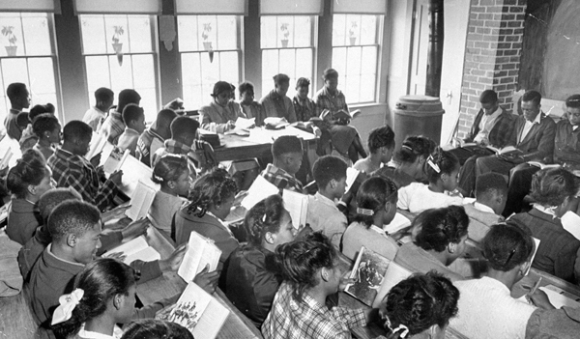
In the South, black schools were often much worse than white schools. In the 1940s, state governments in the South spent twice as much to educate white children and four times as much on white school facilities. Many black students had to make do with poor, unheated classrooms and few books or supplies.

Slide 22
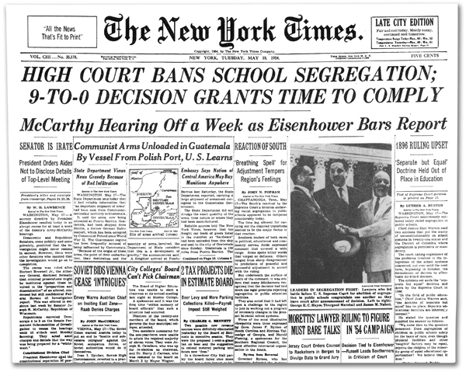
The Supreme Court’s ruling in Brown v. Board of Education was big news across the nation. The headline on this issue of the New York Times was typical of news coverage around the country.

Slide 23
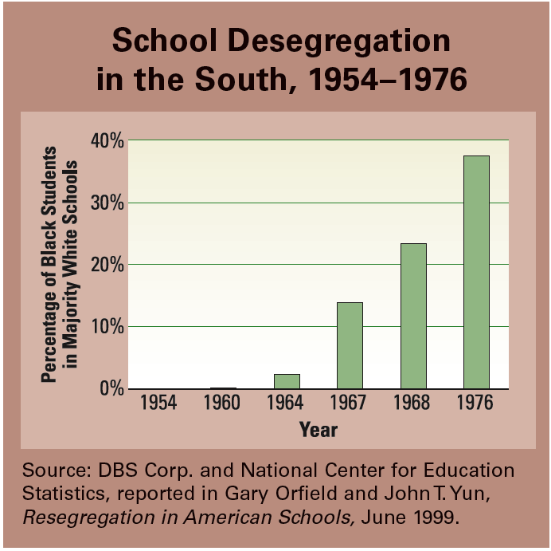
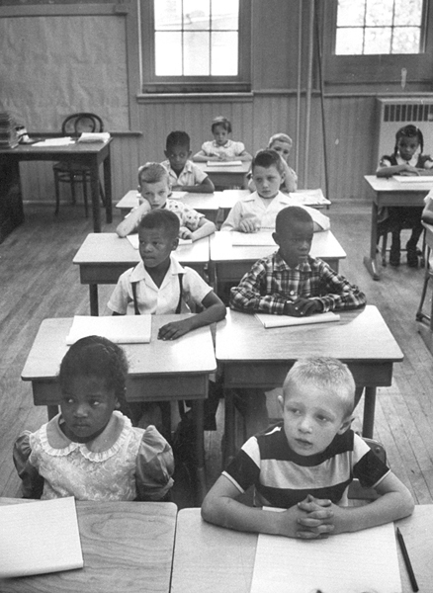
In the first 10 years after the Brown ruling, slow progress was made in school desegregation. After 1964, however, the pace of desegregation quickened.
Some southern states had begun to integrate their schools by the mid-1950s. This photograph of an integrated classroom in Louisville, Kentucky, was taken in 1956.

Slide 24
Chapter 44: Segregation in the Post-WW II Era
Segregation remained widespread in the United States after World War II, especially in the South. But there were also signs of change. In the 1940s and 1950s, desegregation began in sports and the military. Civil rights organizations grew stronger. The landmark Supreme Court ruling Brown v. Board of Education heralded the beginning of the modern civil rights movement.
Segregated society Segregation affected every aspect of life in the Jim Crow South. De jure segregation was defined by law, while de facto segregation was determined by custom. Blacks in the North and West also experienced de facto segregation, especially in housing.
Breaking the color line Professional sports began to be integrated in the late 1940s. Most notable was Jackie Robinson’s entry into major league baseball. The integration of professional football and basketball soon followed.
Executive Order 9981 President Truman was determined to integrate the armed forces. His executive order, issued in 1948, ended segregation in the military.
Civil rights groups Civil rights organizations gained strength in the postwar years. CORE was dedicated to civil rights reform through nonviolent action. The National Urban League tried to help African Americans who were living in northern cities. The NAACP began a legal branch and launched a campaign, led by Thurgood Marshall, to challenge the constitutionality of segregation.
Brown v. Board of Education The NAACP’s legal campaign triumphed in 1954, when the Warren Court issued the Brown v. Board of Education decision. This ruling declared segregation in public schools to be unconstitutional and undermined the legal basis for segregation in other areas of American life.

Slide 25
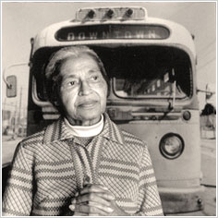
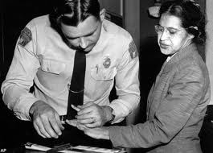
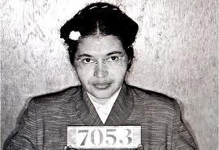
Rosa Parks and the Montgomery Bus Boycott
Was a seamstress (43 years old) with a solid reputation in NAACP
On December 1, 1955 in Montgomery, Alabama, Rosa Parks refused to give up her seat to a white passenger and was arrested
When the driver of the bus said he would call the police she said, “You may go and do so.”
The Montgomery NAACP planned a boycott on Dec. 5th and 90% of blacks who usually rode the buses boycotted and refused to ride the bus
Martin Luther King Jr. led the Montgomery bus boycott which lasted 381 days
Boycott was successful and in November 1956 bus segregation was ruled unconstitutional
Civil disobedience is breaking laws in a “peaceful” way, while activism is protesting in any number intentional ways to promote, impede or direct social, political, economic, or environmental change (ex.writing letters to newspapers or politicians, political campaigning, boycotts or preferentially patronizing businesses, rallies, street marches, strikes, sit-ins, and hunger strikes).
The SCLC (Southern Christian Leadership Conference) vowed that they would not resort to violence to achieve their ends but would remain peaceful and steadfast in their pursuit of justice.

Slide 26
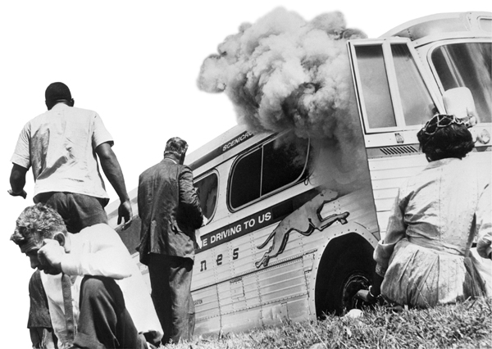
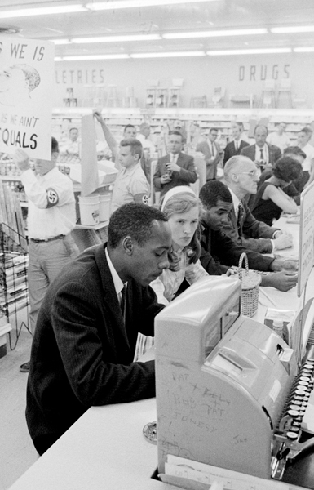
In 1961, the Freedom Riders challenged segregation on interstate buses in the South. They faced mob violence along the way, including the firebombing of their bus outside Anniston, Alabama (shown below). Eventually they traveled with federal escorts to protect them.
ACTIVISM!
Across the South, protesters held sit-ins to integrate lunch counters. The demonstrators remained nonviolent, even when local residents taunted them.

Slide 27
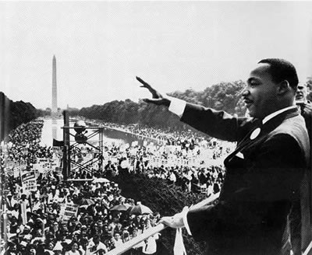
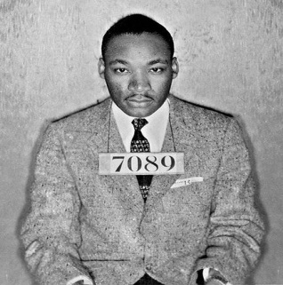
Martin Luther King Jr.
Devoted his life to the civil rights movement and risked his life to change America
President of SCLC (Southern Christian Leadership Conference)
1963: SCLC aided Birmingham activists (non-violent actions against segregation)
As a youth he vowed to “hate all white people.”
Inspired the Civil Rights Act of 1964 with his speeches
His Speech, August 28th, 1963, delivered from Lincoln Memorial, spoke of his “dream” for a better America
April 12, He was arrested with 50 others due to the protests for marching at Birmingham City Hall
He advocated in “Letters from a Birmingham Jail:” explained why African Americans were using civil disobedience and other forms of direct action to protest segregation
The success of the Birmingham Campaign didn’t make changes over night, but increased support for the civil rights movement around the country
“Soul force:” MLK’s brand of non-violent resistance
The government should offer protection by law and enforce violations with military interaction to promote equality and opportunity

Slide 28
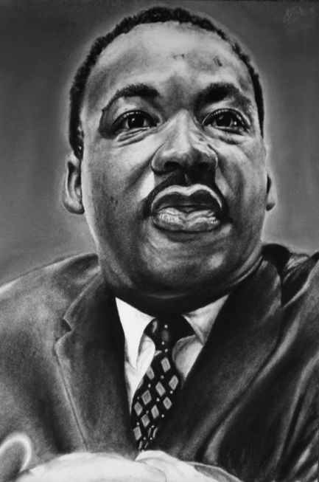
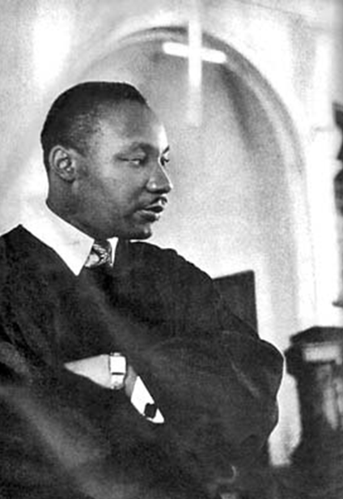
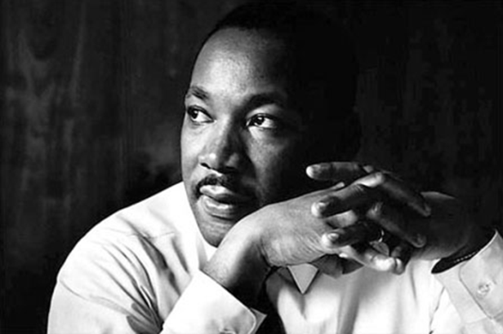
Martin Luther King Jr.
Born Michael Luther King Jr., King had to adjust to a new name in 1934
Great speaker and writer
  Some people, such as those in the Black Panthers, began to challenge the idea that non-violent activism was better than more aggressive (violent?) acts
“Peace is not merely a distant goal that we seek, but a means by which we arrive at that goal.”

Slide 29
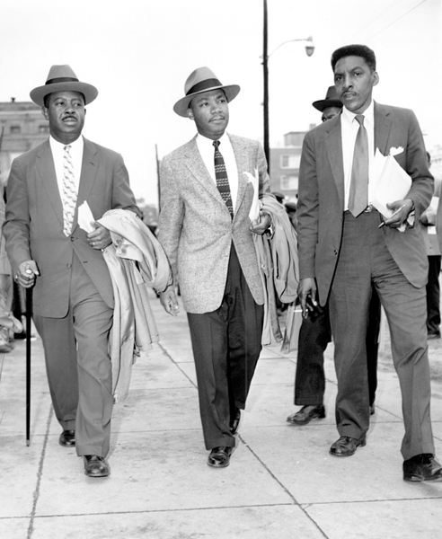
Reverend Martin Luther King Jr. quickly established himself as a leader in the struggle for civil rights.
King’s use of nonviolent protest—which he learned from studying the great Indian leader Mahatma Gandhi—helped shape the civil rights movement.
Here he is walking with two other civil rights leaders, Ralph Abernathy (left) and Bayard Rustin (right).

Slide 30
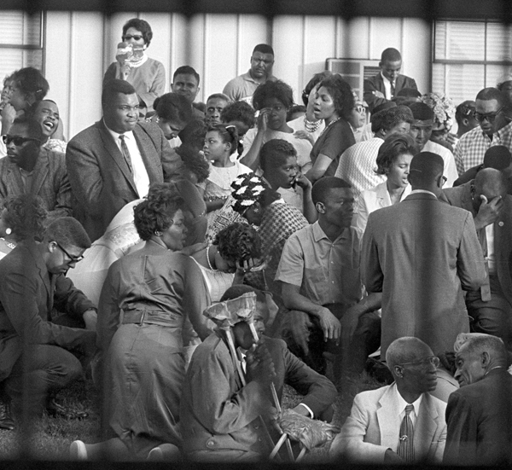
Hundreds of people were arrested and jailed during mass demonstrations in Birmingham in 1963. This photograph of protesters at the jail was taken through the bars of a paddy wagon. Martin Luther King Jr. was one of those arrested. It was at this time that he wrote his famous “Letter from a Birmingham Jail.” In it he said, “Injustice anywhere is a threat to justice everywhere . . . Whatever affects one directly, affects all indirectly.”

Slide 31
Chapter 45: The Civil Rights Revolution: "Like a Mighty Stream"
Between 1955 and 1965, many key events took place in the civil rights movement. African Americans made great progress in their struggle for rights and equality.
Montgomery Bus Boycott In 1955, blacks in Montgomery, Alabama, began a lengthy boycott of the city’s segregated bus system. As a result, Montgomery’s buses were integrated.
SCLC and SNCC These two groups helped organize nonviolent civil rights actions. The Southern Christian Leadership Conference was led by Martin Luther King Jr. It played a major role in the Birmingham campaign and other events. The Student Nonviolent Coordinating Committee organized sit-ins and engaged in other forms of civil disobedience.
Freedom Rides In 1961, black and white Freedom Riders rode buses through the South. They were testing southern compliance with laws outlawing segregation in interstate transport. The riders were subjected to violence and eventually received federal protection.
March on Washington A quarter of a million people marched in Washington, D.C., in August 1963 to demand jobs and freedom. The highlight of this event was Martin Luther King Jr.’s “I have a dream” speech.
Freedom Summer In the summer of 1964, activists led voter registration drives in the South for African Americans.
Landmark legislation The Civil Rights Act of 1964 banned discrimination on the basis of race, sex, religion, or national origin. The Voting Rights Act of 1965 outlawed literacy tests, enabling many African Americans to vote.

Slide 32
Chapter 21 Americans, p. 698-727
Civil Rights
1. How did the civil rights movement begin?
The civil rights movement began with changes caused by World War II. The NAACP pushed lawsuits that won African Americans the right to desegregation in education. The Montgomery bus boycott (Rosa Parks) prompted the rise of Martin Luther King, Jr., as a leader of the movement.
-Tuskeegee Airmen… “Redtails”
-Brown v. Board of Education Topeka, Kansas (1954)
-

Slide 33
Chapter 21, Americans, p. 698-727
Civil Rights
2. What events led Congress to pass the Civil Rights and Voting Rights acts?
Violent attacks on civil rights workers in the South prompted President Kennedy to ask Congress for a civil rights law. A massive march on Washington and his assassination, as well as President Lyndon B. Johnson’s skill (JFK’s VP & successor), led to its passage in 1964. The Voting Rights Act (1965) was passed due to Johnson’s support after another massive march in the South.
-SNCC? Freedom Rides? Freedom Summer?
-Gov. George Wallace (Alabama)…segregationist who ran for president
-SCLC?

Slide 34
Chapter 21, Civil Rights Americans, p. 698-727
4. Why could the results of the movement be called mixed?
The civil rights movement had mixed results in that it succeeded in overturning many discriminatory laws but could not unseat entrenched de facto discrimination. Many African Americans still suffer from poverty and the lack of opportunities.

Slide 35
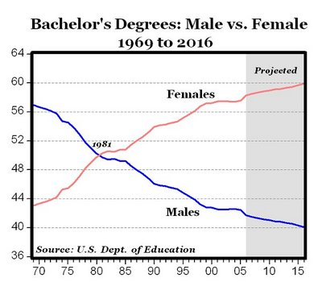
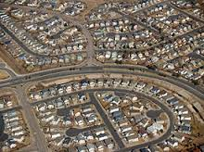
Visual Prep

Slide 36
Women’s Liberation Movement
The Americans, Ch. 23, p. 776-780
sexism: oppression of women in the workplace
feminism: the movement for women's equality
women's liberation: emancipation of women from customs and laws that kept them subordinate to men
ERA: Equal Rights Amendment-“equality of rights under the law shall not be denied or abridged by the United States or by any state on account of sex.” It was passed by Congress in 1972, but failed to gain support of ¾ of the states (only had 35 of necessary 38) so it was NOT ratified.
NOW: National Organization for Women (1966) and other feminist groups worked for women’s rights. They wanted reforms to ensure greater equality and opportunity for women
Birth Control Pill (1960) & abortion were essential rights for many feminists. 65 million women were using the pill by 1965, and Roe v. Wade (1973) legalized a woman’s right to decide whether or not to terminate her pregnancy.

Slide 37
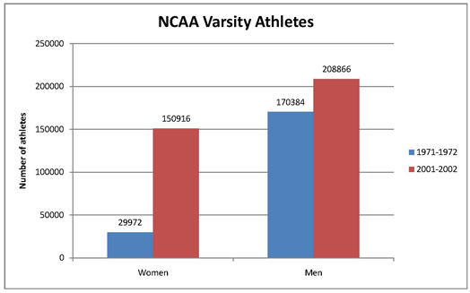
Women’s Liberation Movement
The Americans, Ch. 23, p. 776-780
Despite that loss, women’s efforts to attain equal rights succeeded on many fronts. Some clear examples came in education. Between 1969 and 1973, the number of women law students nearly quadrupled, while the number of women medical students almost doubled. By 1997, women made up the majority of college students and earned the majority of master’s degrees.
Women’s opportunities in education were enhanced by federal legislation. A law called Title IX of the Educational Amendments of 1972 prohibited discrimination on the basis of sex in any school program receiving federal funds, including school athletics.

Slide 38
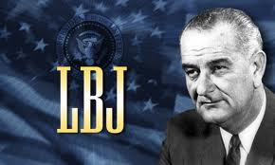
Chapter 20
The New Frontier and the Great Society
esp. p. 686-693; 696
3. Describe Johnson’s Great Society.
Johnson’s Great Society comprised many measures such as civil rights protection, Medicare and Medicaid to provide health care for the aged and poor, funding for public housing, an end to immigration quotas, efforts to clean water, and consumer protection.

Slide 39
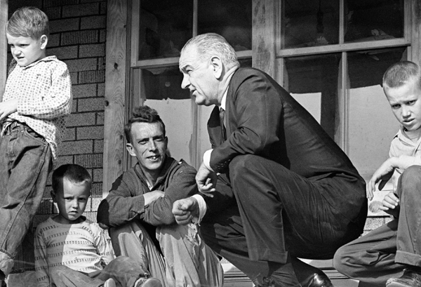
Great Society
President Lyndon Johnson's domestic reform program from 1965 to 1969, which focused on social welfare improvements, with the War on Poverty at its centerpiece, and almost all of which Congress passed.
President Johnson once said he wanted to be president so he could “give things to people —all sorts of things to all sorts of people, especially the poor and the blacks.” His vision of the Great Society reflected that desire.

Slide 40
The Great Society
What is the proper role of government in shaping American society?
In 1964, voters elected liberal Democrat Lyndon Johnson by a wide margin. Johnson used this mandate to enact a broad program of reforms he called the Great Society. With his powers of persuasion, Johnson pushed more than 200 bills through Congress.
War on Poverty Johnson’s Great Society grew out of the liberal tradition of the Progressive and New Deal eras. Its centerpiece was an ambitious War on Poverty.
Economic Opportunity Act This act created a number of antipoverty measures, including the Job Corps, Project Head Start, and VISTA (Volunteers in Service to America), which all helped cut poverty rates almost in half.
Medicare and Medicaid As part of the Great Society, Congress amended the Social Security Act to include medical health insurance for the elderly and disabled.
Immigration Act of 1965 This measure ended the national origins quota system begun in the 1920s. Entry to the United States was now based on criteria such as skills and family ties.
Silent Spring This influential book by Rachel Carson sparked a new interest in environmentalism. As a result, Congress passed several environmental laws.

Slide 41
Chapter 22 The Vietnam War Years
1. Why did the U.S. enter the war in Vietnam?
The U.S. entered the war in Vietnam to try to support the government of the South because it did not want communists in the North to control the whole country. (containment)

Slide 42
Chapter 22 The Vietnam War Years
2. Why could the U.S. not win a quick victory over
the Vietcong, and what was the effect?
The U.S. could not quickly defeat the Vietcong because they engaged in guerrilla tactics of quick attacks and disappearing into the jungle. The result was a loss of morale among U.S. soldiers.

Slide 43
Chapter 22 The Vietnam War Years
3. How did public opinion split over the war?
As the war continued and victory seemed less achievable, American society split into hawks, who favored the war, and doves, who opposed it. They were bitterly opposed to each other, and some hawks thought that antiwar protesters were disloyal.

Slide 44
Chapter 22 The Vietnam War Years
4. Why is 1968 considered a year of upheaval?
The year 1968 was marked by loss of confidence and violence: a major North Vietnamese offensive weakened American support for fighting the war. Also, President Johnson decided not to seek re-election, two major leaders were killed, and violence marred the Democratic convention.

Slide 45
Chapter 22 The Vietnam War Years
5. What were the effects of the war?
As a result of the war in Vietnam, many American soldiers were dead or wounded, and many more scarred by their reception when they returned
home. The war created deep divisions in American society and opened mistrust of people toward the government.

Slide 46
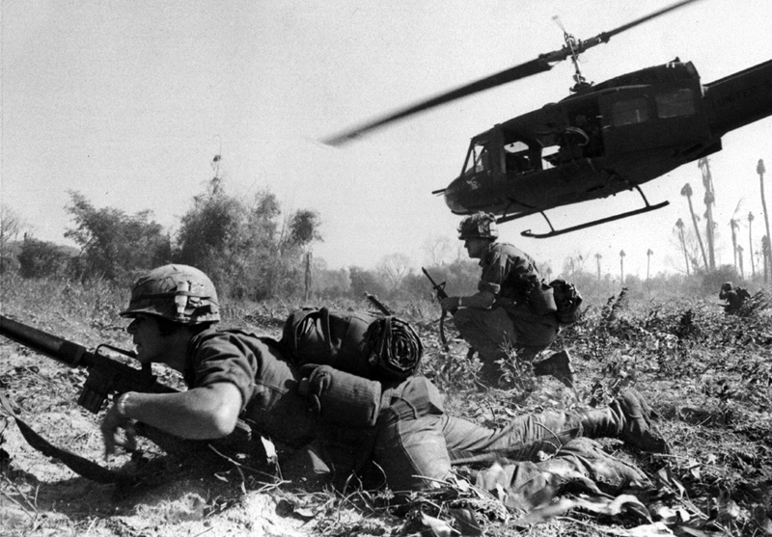
Vietnam War
U.S. involvement ended on August 15, 1973 as a result of the Case–Church Amendment passed by the U.S. Congress. The capture of Saigon by the Vietnam People's Army in April 1975 marked the end of the war, and North and South Vietnam were reunified the following year.
The Vietnam War was a Cold War-era military conflict that occurred in Vietnam, Laos, and Cambodia from November 1, 1955 to the fall of Saigon on April 30, 1975. This war was fought between North Vietnam, supported by its communist allies, and the government of South Vietnam, supported by the United States and other anti-communist countries.
The Viet Cong (also known as the National Liberation Front, or NLF), a lightly armed South Vietnamese communist-controlled common front, largely fought a guerrilla war against anti-communist forces in the region. The Vietnam People's Army (North Vietnamese Army) engaged in a more conventional war, at times committing large units into battle. U.S. and South Vietnamese forces relied on air superiority and overwhelming firepower to conduct search and destroy operations, involving ground forces, artillery, and airstrikes.

Slide 47
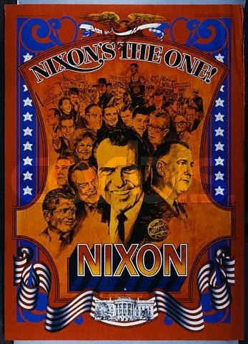
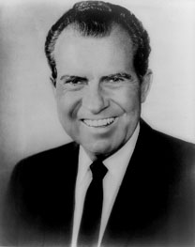
Richard Nixon
#37: Republican
(1969-1974)
In his 1968 presidential election campaign, Nixon reached out to moderate, middle-of-the-road voters. In a pamphlet titled “The Nixon Stand,” he outlined his position on five key issues facing the country. He defined these issues as winning the peace, fighting rising crime, progress with order, preventing runaway government, and respect for America.

Slide 48
Watergate scandal, Ch. 24, p. 802-807
Richard Nixon won the presidency in 1968. While in office, he made strides toward easing the tensions of the Cold War. He also saw many of his domestic policies enacted. However, scandal forced him to resign in disgrace in 1974.
Watergate scandal: In 1972, burglars broke into Democratic headquarters in the Watergate building. The scandal over the cover-up that followed the break-in led to Richard Nixon’s resignation in 1974.
a political scandal from 1972 to 1975 in which President Richard Nixon and members of his staff organized a burglary of the Democratic National Committee's headquarters in the Watergate building and then attempted to cover up their illegal activities, leading to prison terms for many involved and Nixon's impeachment

Slide 49
Three Mile Island, Ch. 24, p. 820-825
a disaster that occurred at Pennsylvania's Three Mile Island Nuclear Generating Station on March 28, 1979, when the nuclear power plant suffered a partial meltdown, allowing radioactive gases to escape into the atmosphere and highlighting the potential danger of nuclear power plants
Many Americans were convinced that nuclear power plants posed an unacceptable risk to people and the natural environment. As a result, no new nuclear power plants have been built in the United States since 1979. BUT...
Environmental Protection Agency The EPA, was created during Nixon’s administration to protect Americans’ health and the natural environment.

